Slide 1
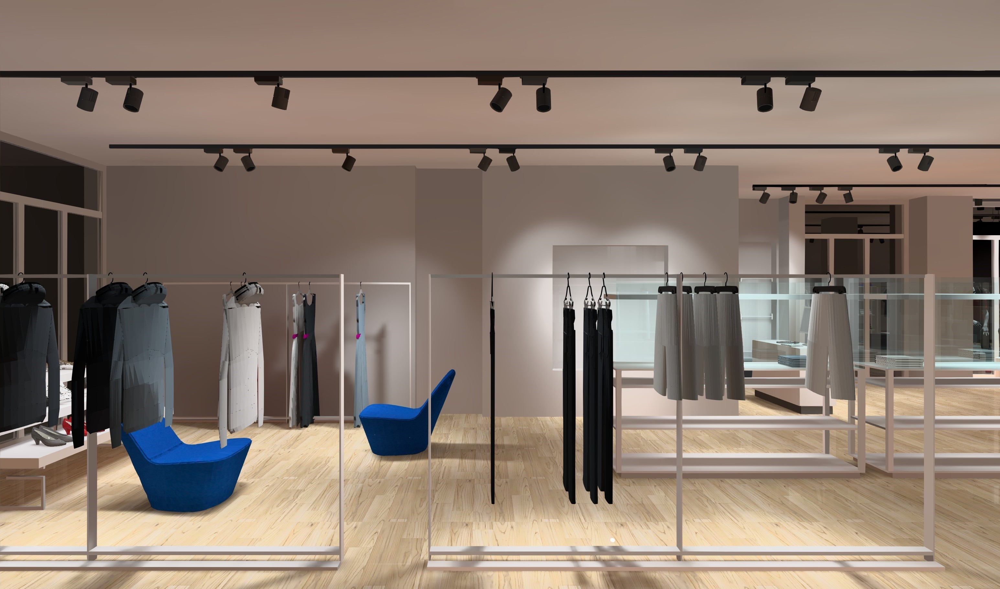
RETAIL LIGHTING DESIGN
The SLL Lighting Handbook, Chapter 12
Nelca Roco
L I G H T I N G D E S I G N S

Slide 2
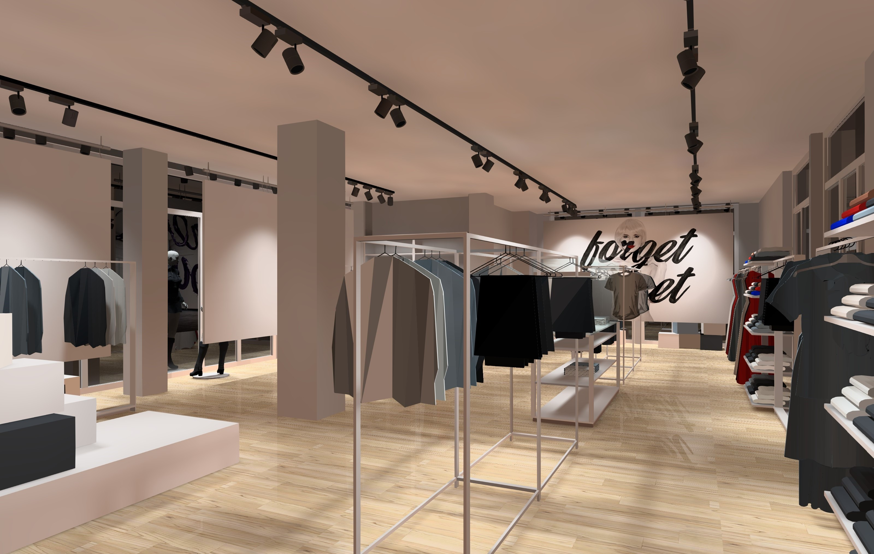
RETAIL LIGHTING DESIGN
12.1 Functions of Retail Lighting
To attract attention
To send message about the nature of shop
To guide shoppers around the shop
To display the merchandize, and
To encourage customers to buy
Notes:
Lighting is essential in calling attention to merchandise in a display. A shopper’s eye is drawn automatically to the brightest item or area. Lighting treatment may be used to draw attention to part of the display area, a specific item in the display, or to coordinate parts of the total display area. Lighting can also be used to direct shoppers through the store, attracting them to various displays along the way. Because of this tendency to follow a lighted path, display lights should be two to five times stronger than lighting in other parts of the store.

Slide 3
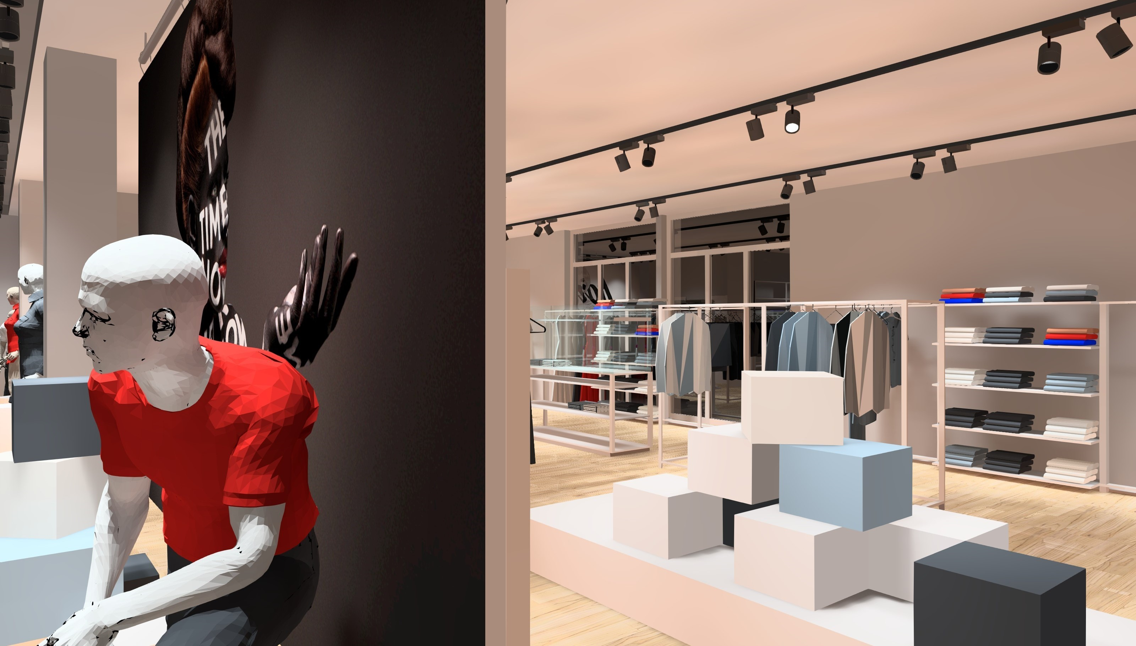
RETAIL LIGHTING DESIGN
12.2 Factors to be considered
Shop Profile
Daylight or Electric Light
Nature of Merchandize
Obstruction
Table 12.1 Four Common Shop Profile
Shop Profile | Prices | Usage | Product Range | Sales Style
Low Budget | Bargain | Weekly | Wide | Self Service
Value for Money | Low | Daily | Limited | Social Contact
Quality | Higher | Impulse | Wide | Shopping as fun
Exclusive | Expensive | Deliberate | Exclusive | Personal Service
Shop profiles matter because different profiles have different lighting styles.

Slide 4
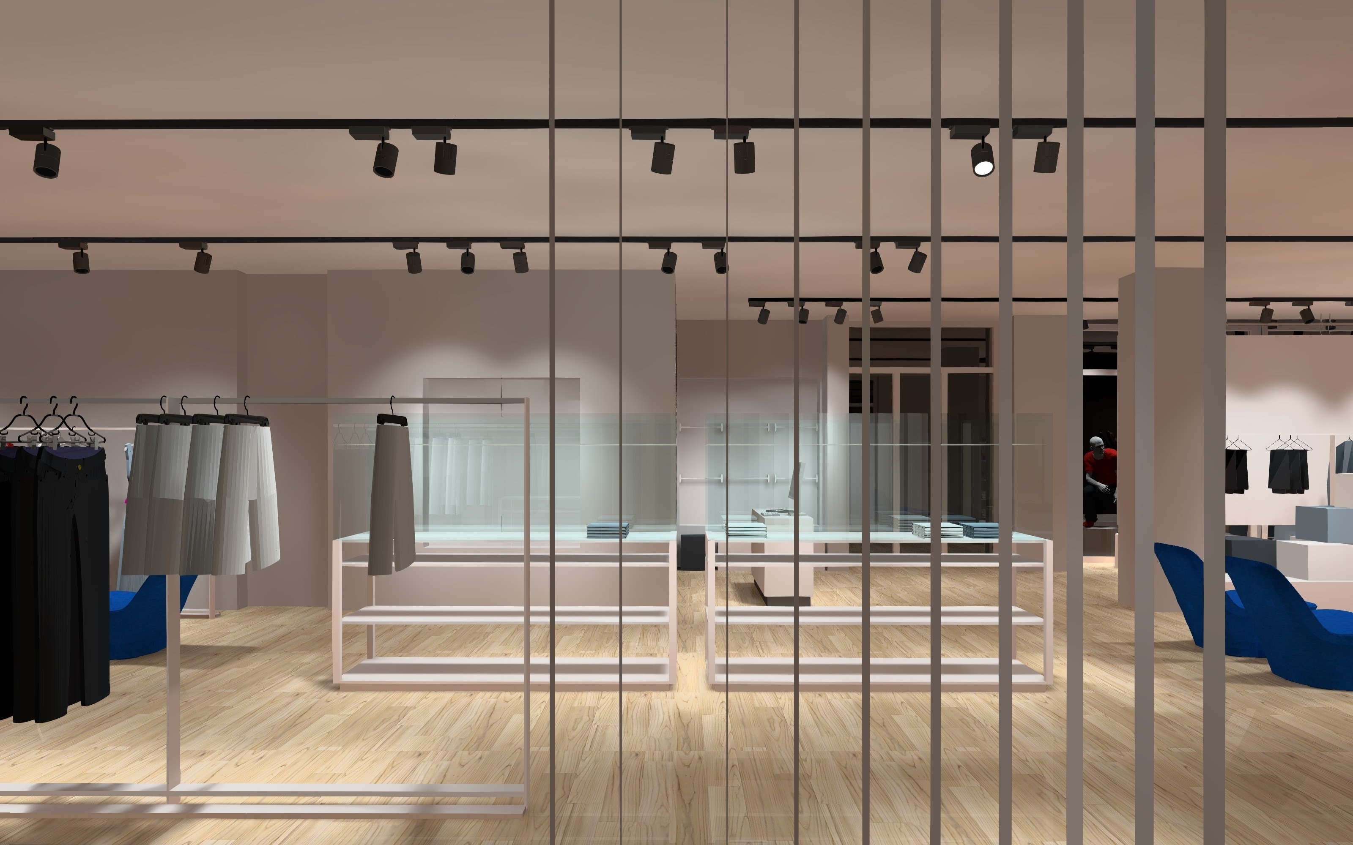
RETAIL LIGHTING DESIGN
12.2 Factors to be considered
Shop Profile
Daylight or Electric Light
Nature of Merchandize
Obstruction
The use of daylight adds an attractive dynamic element to the store.

Slide 5
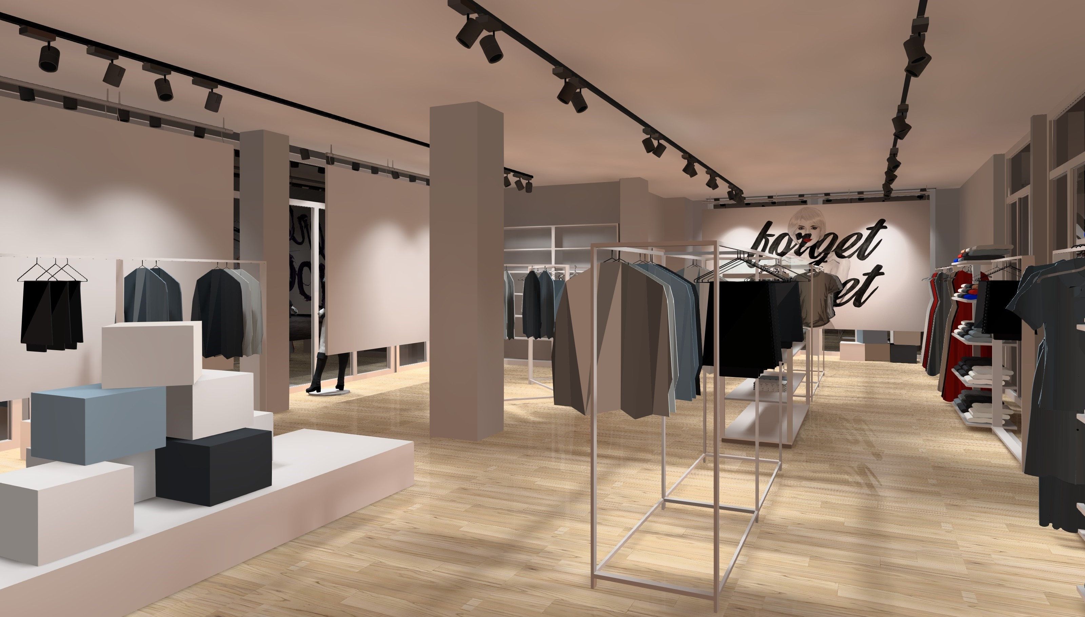
RETAIL LIGHTING DESIGN
12.2 Factors to be considered
Shop Profile
Daylight or Electric Light
Nature of Merchandize
Obstruction
The type of lighting and the color of the light sources used depend on the nature of the merchandize.

Slide 6
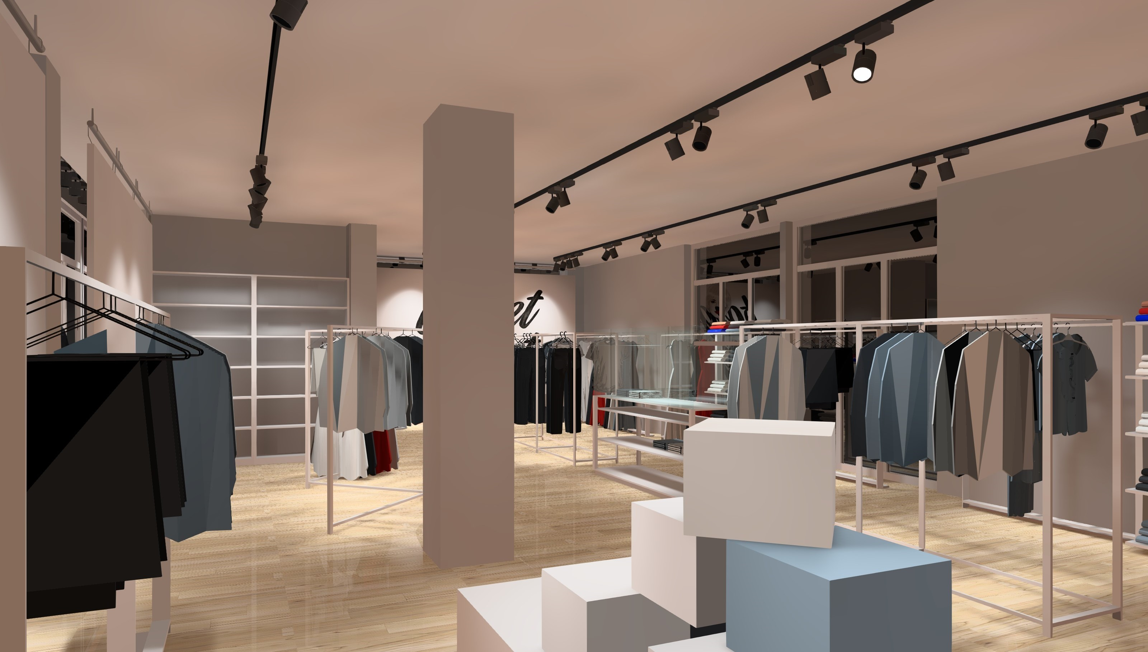
RETAIL LIGHTING DESIGN
12.2 Factors to be considered
Shop Profile
Daylight or Electric Light
Nature of Merchandize
Obstruction
When obstruction occurs, like racks extending to head height and above, it is essential that the layout of the lighting and the merchandize is coordinated.

Slide 7
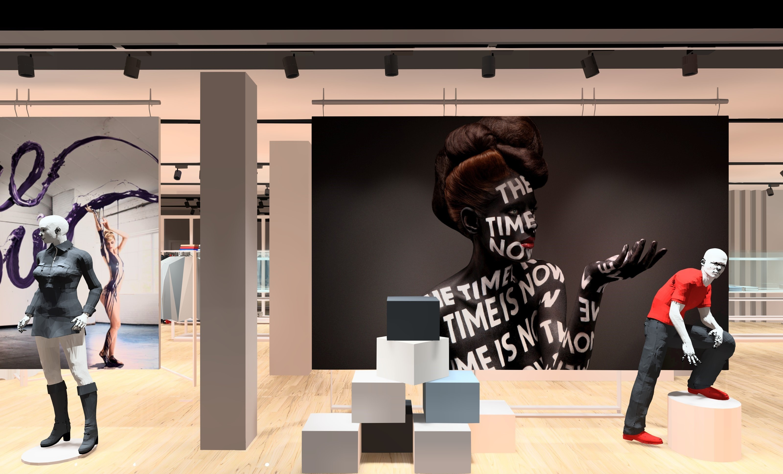
RETAIL LIGHTING DESIGN
12.3 Lighting recommendations
Illuminances
Illuminance uniformity
Luminances
Light source color properties

Slide 8
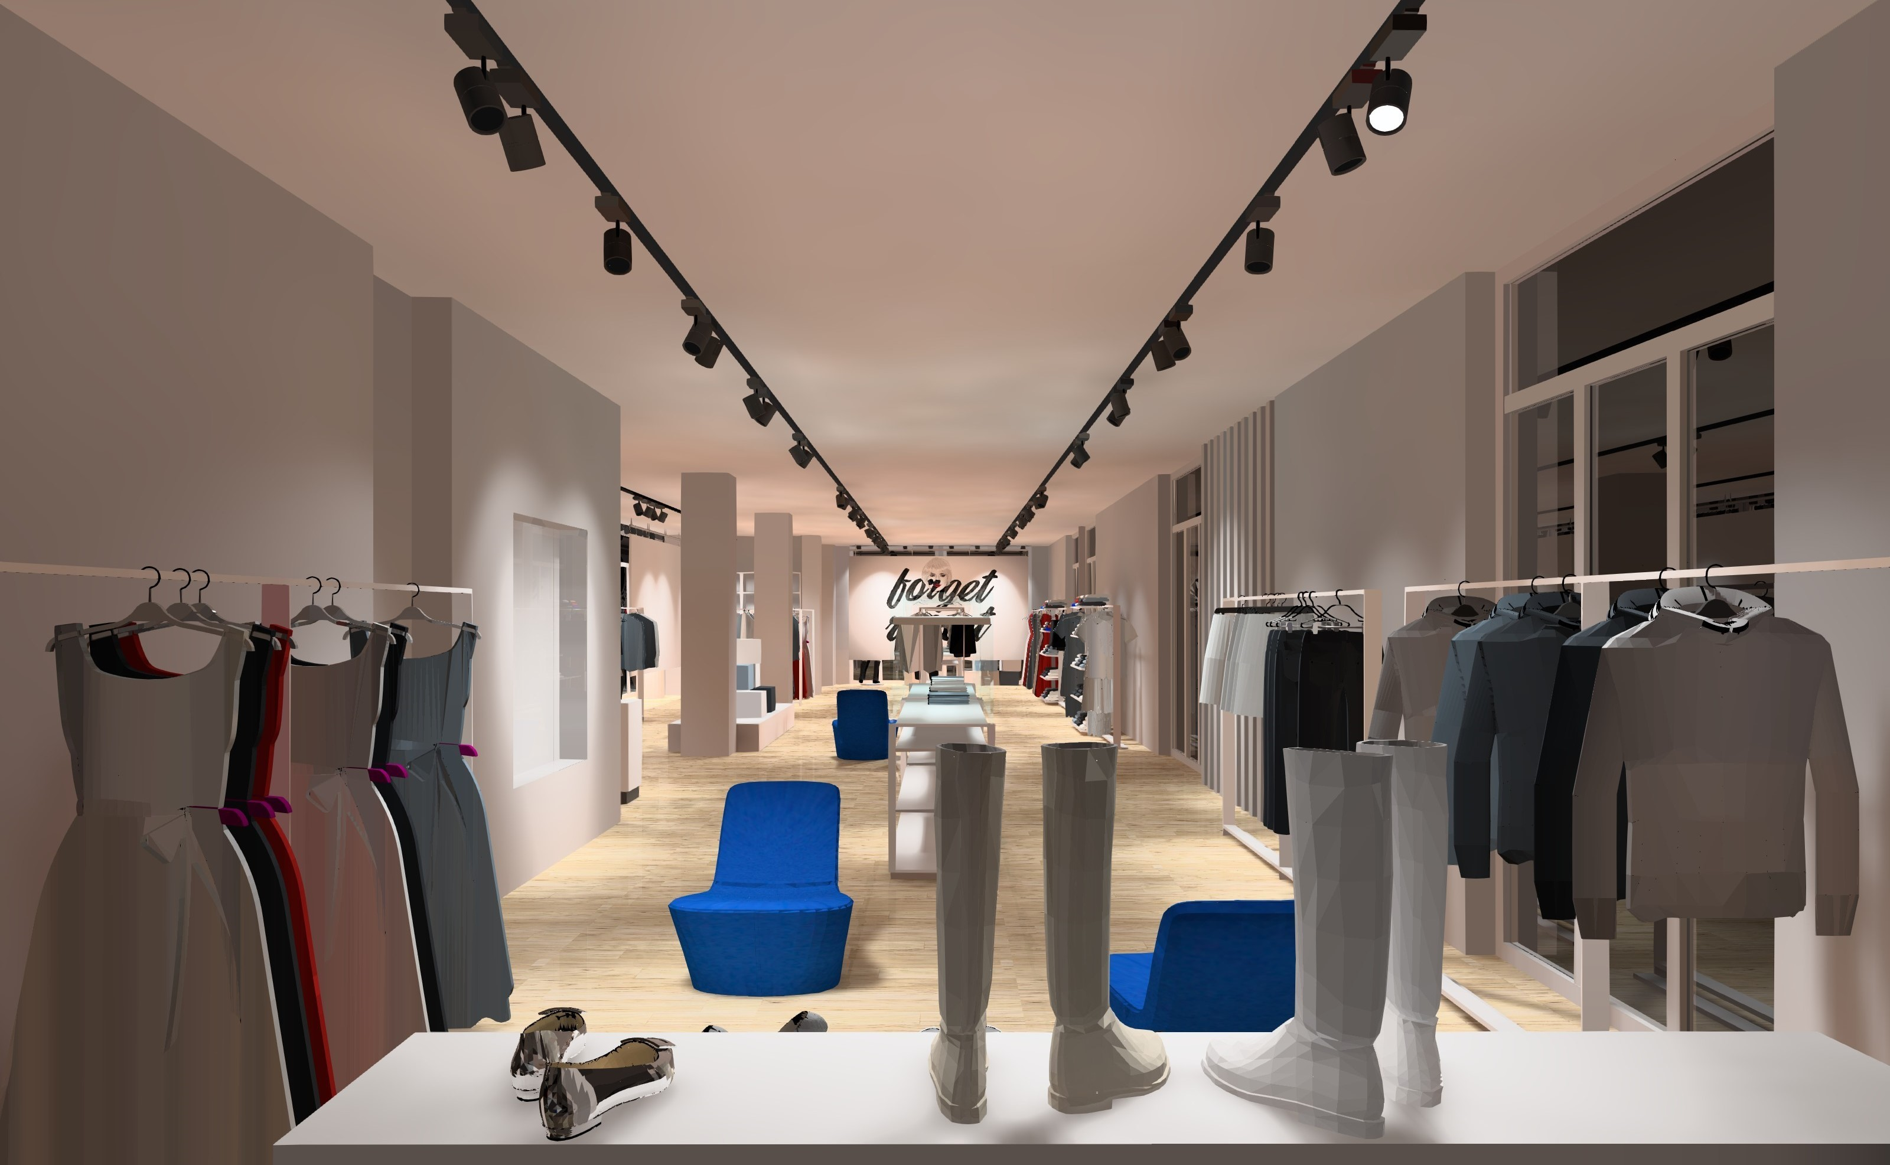
RETAIL LIGHTING DESIGN
12.3 Lighting recommendations
Illuminances
Illuminance uniformity
Luminances
Light source color properties
Retail Lighting is essentially a balance between general lighting, accent lighting, and display lighting. This balance itself depends on the shop profile.
1. Low budget = 500 to 1000 lux general (including vertical)
2. Value for Money = 250 to 500lux general (with some accent lighting)
3. Quality = 250 to 500lux general (with accent lighting)
4. Exclusive = 100 to 200lux general (mostly accent and display lighting).

Slide 9
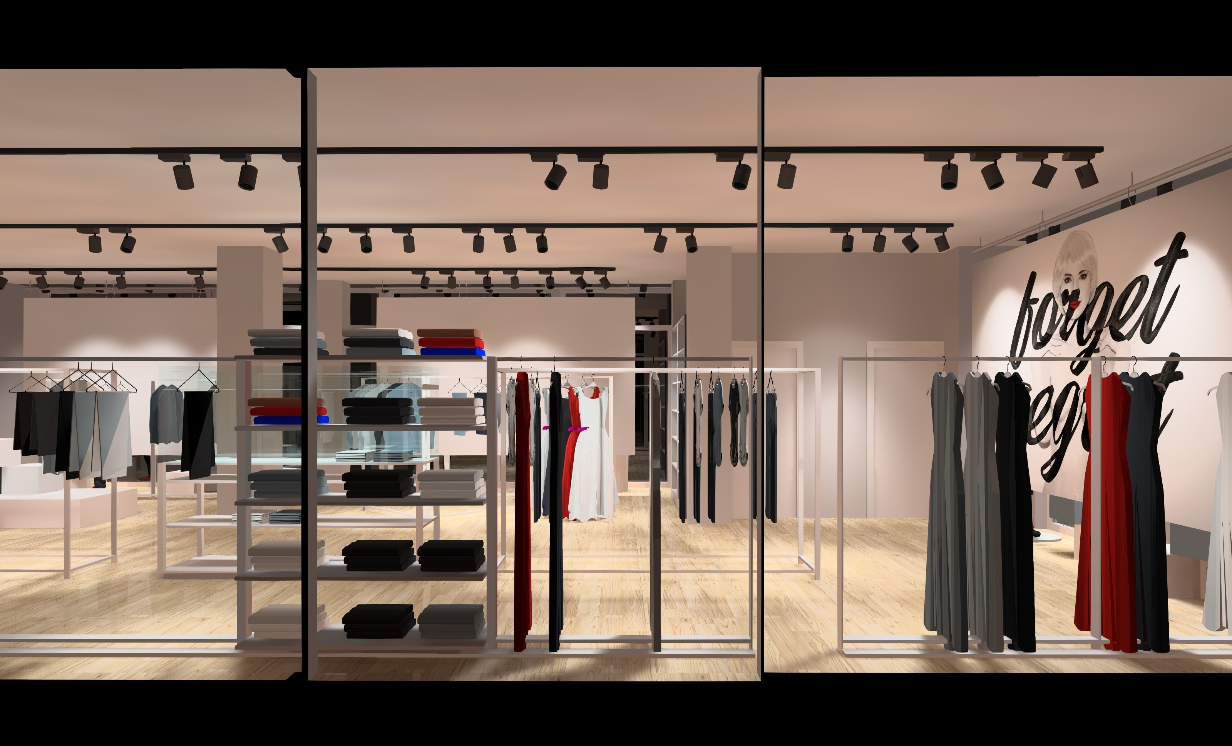
RETAIL LIGHTING DESIGN
12.3 Lighting recommendations
Illuminances
Illuminance uniformity
Luminances
Light source color properties
Regardless of the shop profile, general lighting should be uniform.
At least 0.70 overall uniformity (Uo).

Slide 10
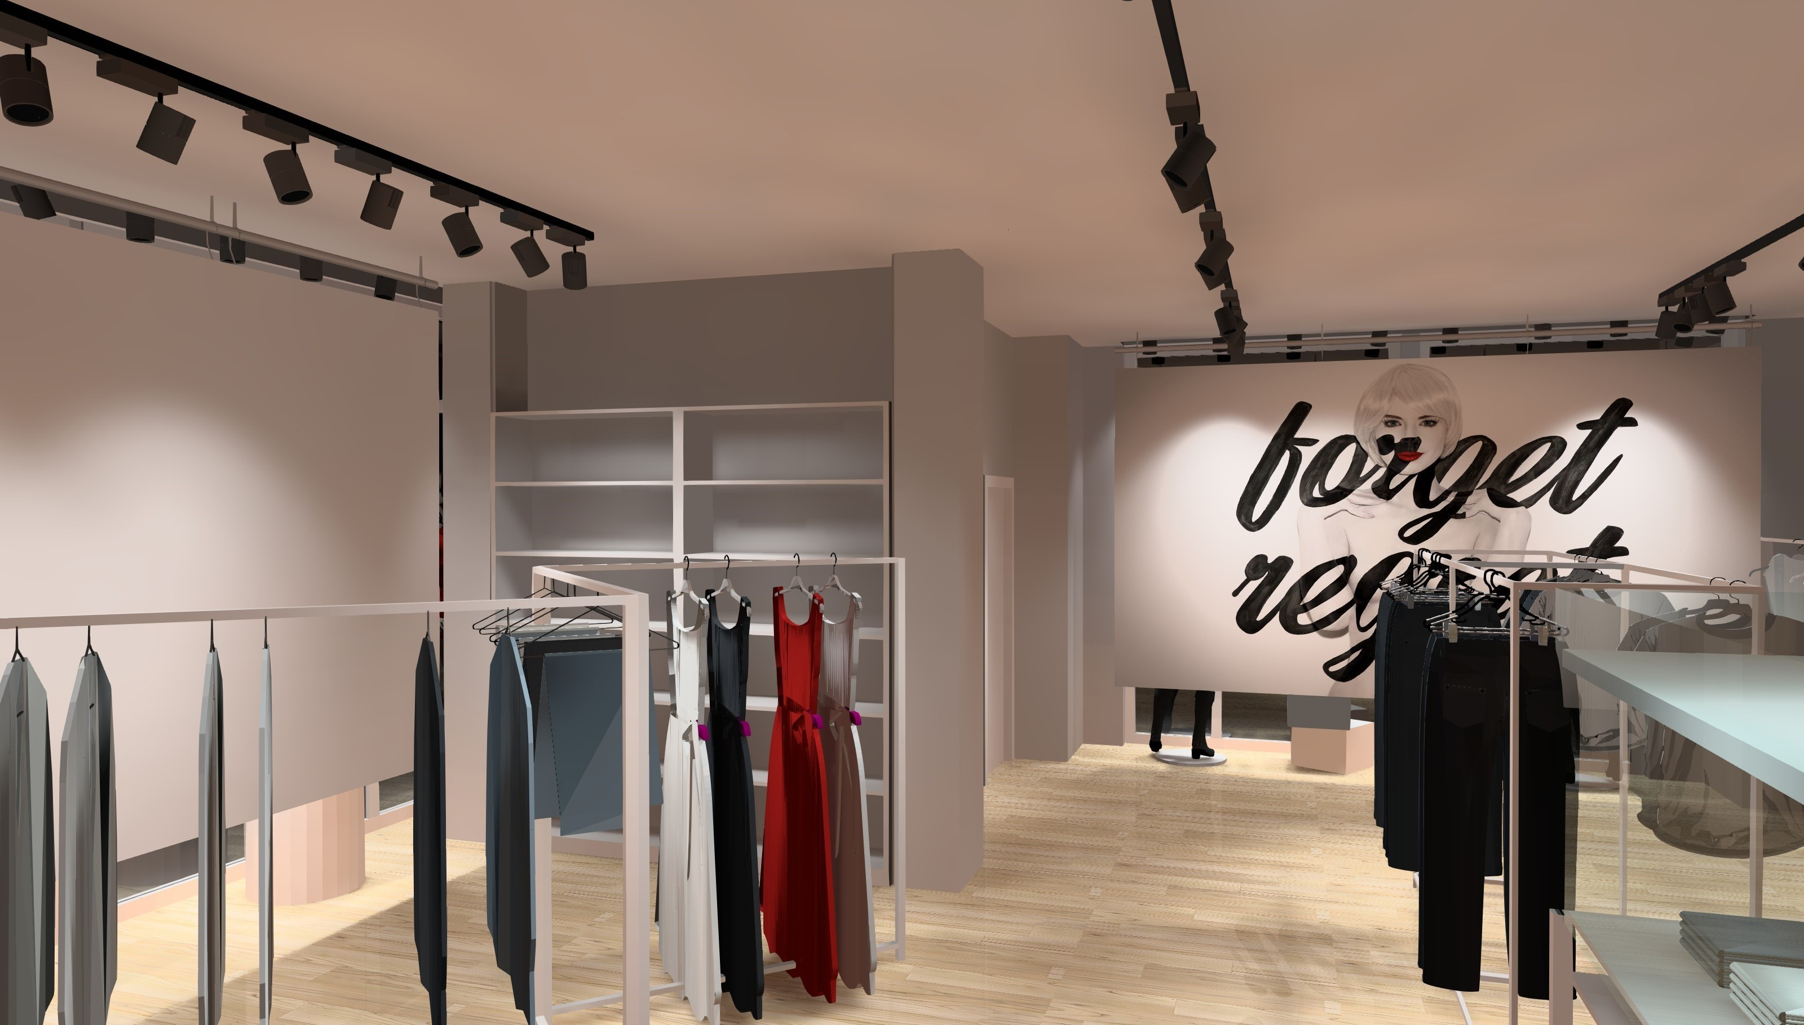
RETAIL LIGHTING DESIGN
12.3 Lighting recommendations
Illuminances
Illuminance uniformity
Luminances
Light source color properties
The luminance of the merchandize lit has to be higher than the luminance of its immediate background.
Table 12.2 Luminance ratios for different strengths of accent lighting
Luminance Ratio (accent/background) | Strength of accenting
1 | None
2 | Noticeable
5 | Low theatrical
15 | Theatrical
30 | Dramatic
>50 | Very dramatic
Notes:
Lighting is an important part of a total shop concept; it can evoke feelings, strengthen your brand and effect sales. Our mission is to use lighting as a tool to enhance the shopping experience.
We feel passionate about retail lighting and can cover the entire spectrum of your lighting project – with high-quality products, education, concept development, on demand design, light planning, aiming and, crucially, on-going maintenance.

Slide 11
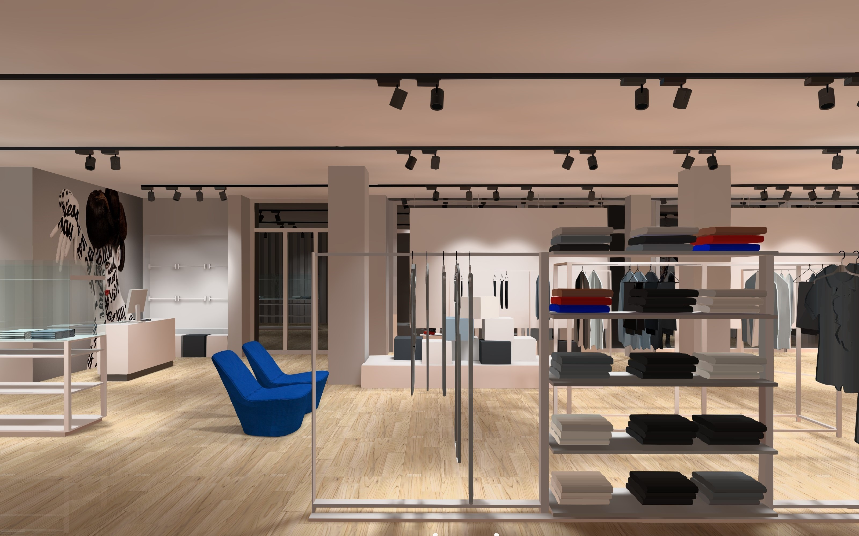
RETAIL LIGHTING DESIGN
12.3 Lighting recommendations
Illuminances
Illuminance uniformity
Luminances
Light source color properties
A cool light appearance tends to convey a business-like atmosphere while a warm color appearance indicates a homely feel.
Colour rendering index (CRI) greater than 80 should be used in retail premises.
It is important to choose a light source with colour rendering properties that gives an appealing appearance to human skin.

Slide 12
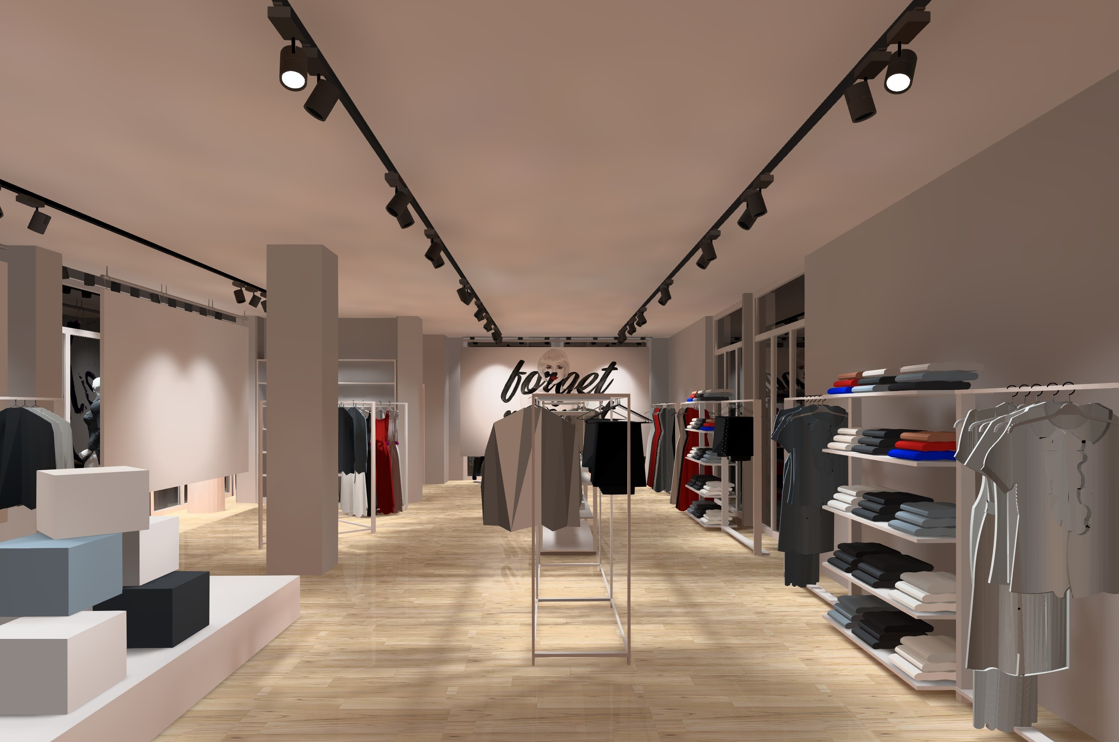
RETAIL LIGHTING DESIGN
12.4 Approaches to retail lighting
General lighting
Accent lighting
Display lighting

Slide 13
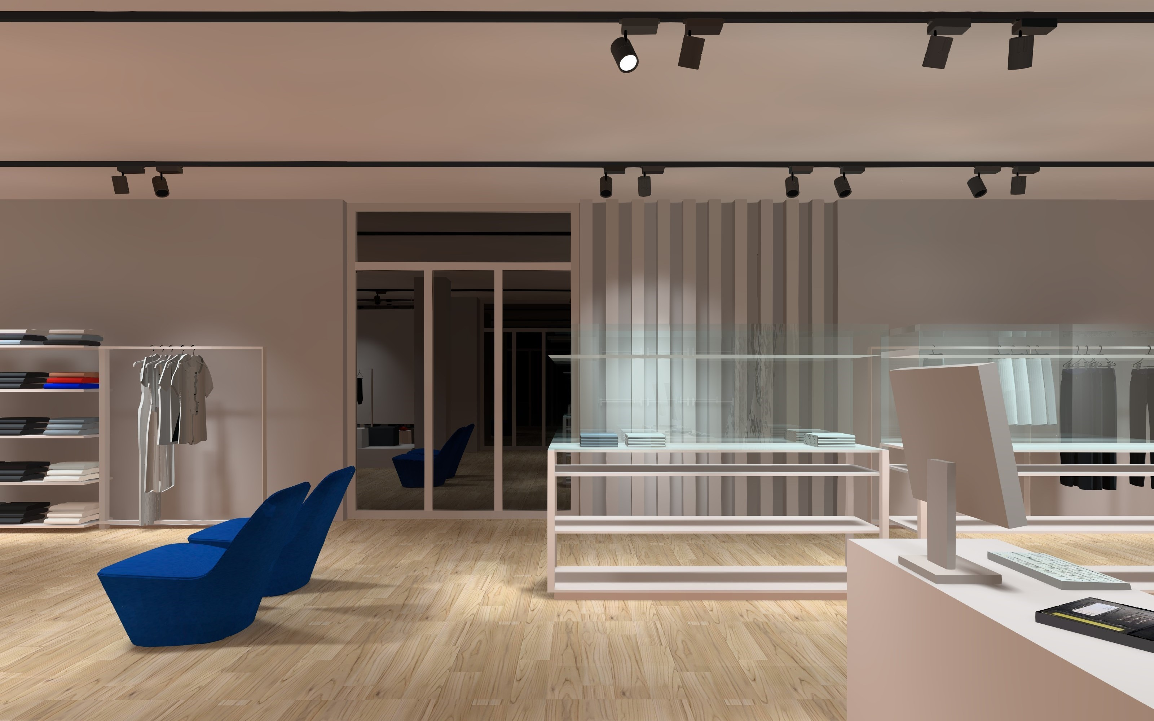
RETAIL LIGHTING DESIGN
12.4 Approaches to retail lighting
General lighting
Accent lighting
Display lighting
The purpose of general lighting is to produce a uniform illuminance over the relevant plane without causing glare.
Regardless of the lighting approach used, the appearance of the luminaires needs to be consistent with the style of the shop.

Slide 14
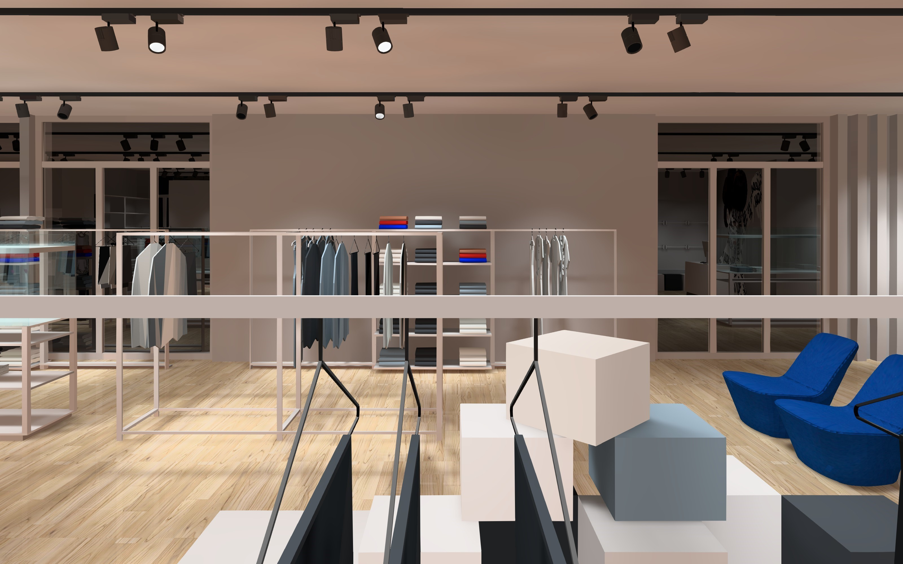
RETAIL LIGHTING DESIGN
12.4 Approaches to retail lighting
General lighting
Accent lighting
Display lighting
Accent Lighting is designed to provide additional illuminance on some areas so as to emphasize specific items of merchandize and to provide meaningful variation in brightness and shadow throughout the store.
Whatever the form of accent lighting, some flexibility is required. This is because the nature and aiming will depend on the merchandize to be accented.

Slide 15
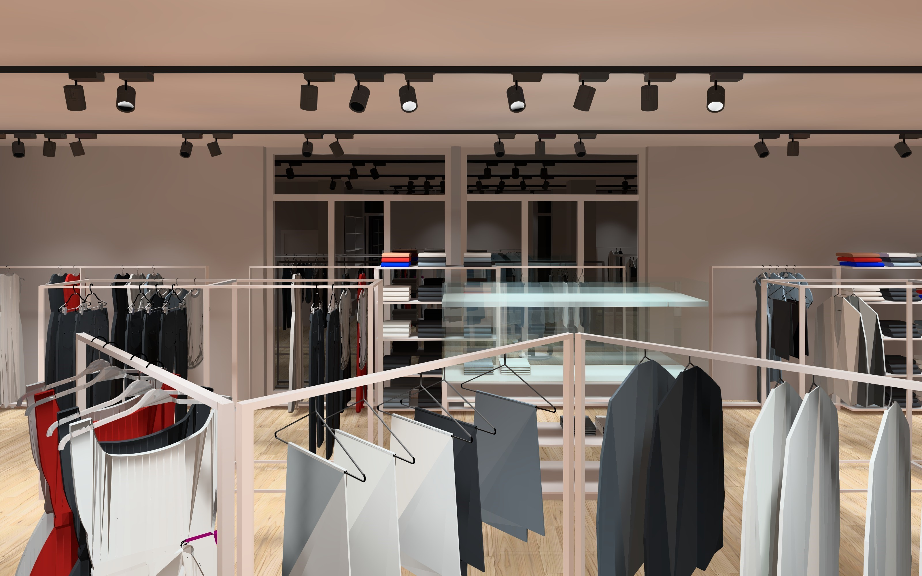
RETAIL LIGHTING DESIGN
12.4 Approaches to retail lighting
General lighting
Accent lighting
Display lighting
The function of display lighting in shop is to gain attention of passersby and to make merchandize look attractive.
The higher the illuminance ratio, the more likely the display is to gain attention.
Modelling is usually achieved by some combination of key-light, fill-light, back-light and up-light.

Slide 16
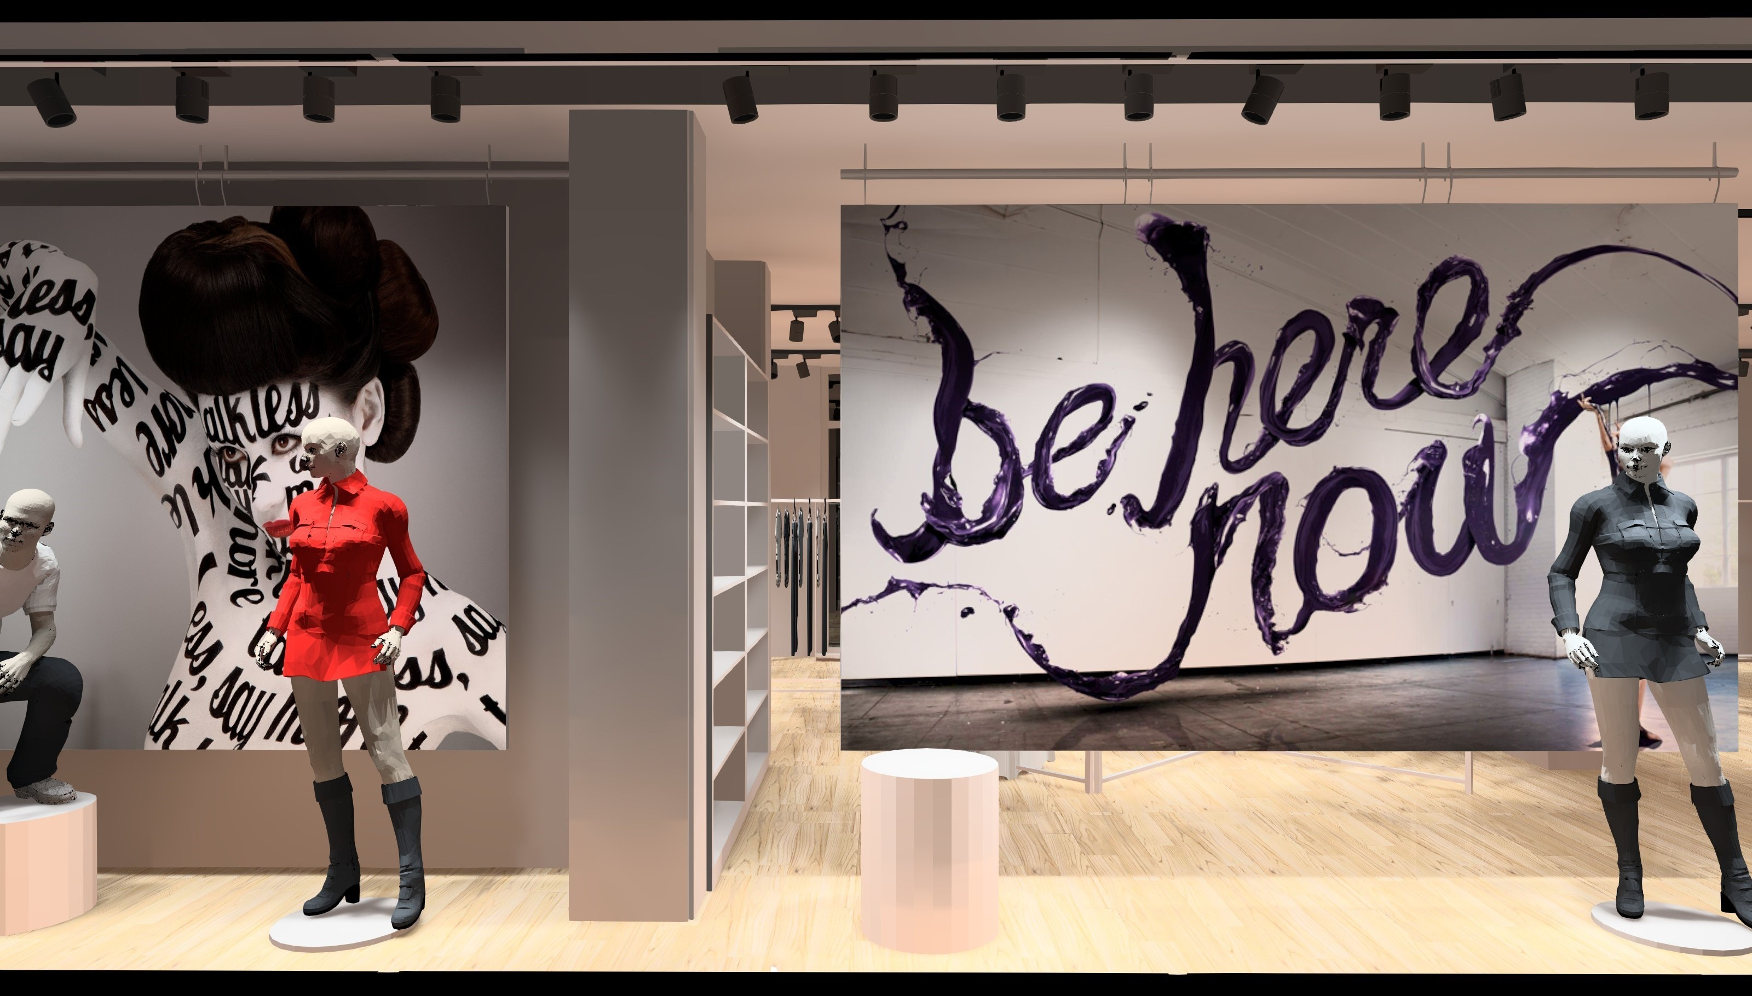
RETAIL LIGHTING DESIGN
12.4 Approaches to retail lighting
General lighting
Accent lighting
Display lighting
Table 12.3 Descriptions of the components of display lighting
Light | Description | Function
Key-light | The principle source of directional illumination. | To create sparkle and reveal texture.
Fill-light | Supplementary illumination from a different direction. | To soften shadows so as to get the contrasts in the display as the desired level.
Back-light | Illumination from behind and usually above. | To separate the object from its background, to reveal transparent elements.
Up-light | Light accentuating parts of the display close to the floor. | To soften shadows, can be used for dramatic effects.

Slide 17
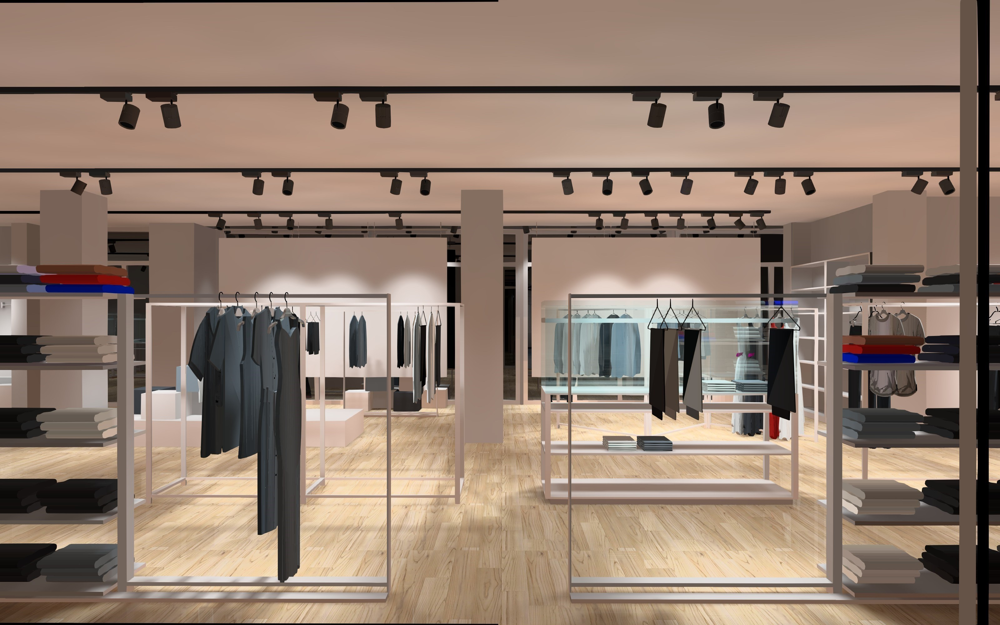
RETAIL LIGHTING DESIGN
12.4 Approaches to retail lighting
General lighting
Accent lighting
Display lighting
Table 12.4 Common display lighting techniques for particular materials
Materials | Display Lighting Technique
Uniformly transparent materials | Transmitted light from a lit background; up-lighting possibly in colour
Glass and crystal | Highlighting, up-lighting possibly in combination with translucent background lighting; coloured light
Transparent fibrous objects, e.g. fine textiles | Contour lighting from behind
Precious stones and jewelry | Small spotlights, black velvet background, highlighting
Opaque, shiny objects, e.g. silver | Spotlights, black velvet background, highlighting
Opaque, textured objects | Light predominantly glancing across the surface

Slide 18
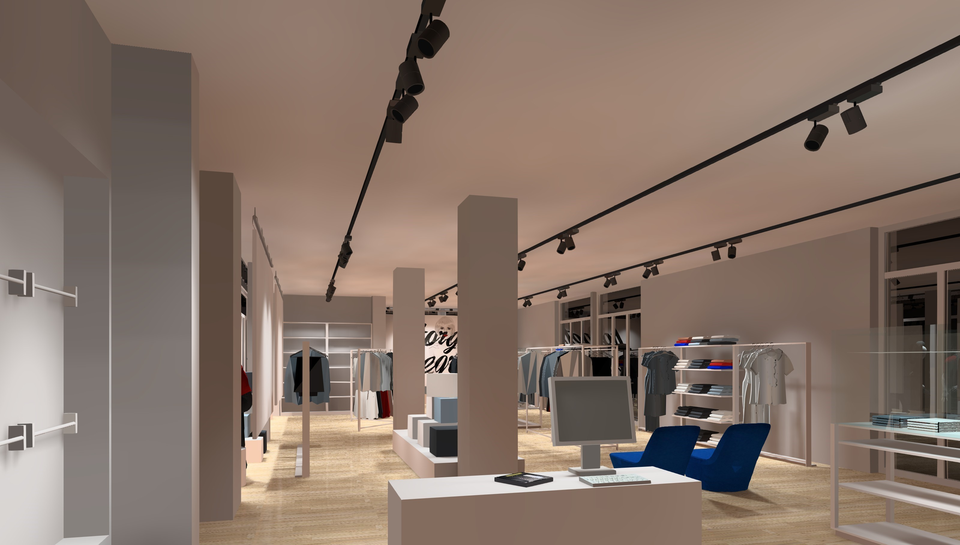
THANK YOU!
END OF PRESENTATION
www.nrocolightingdesign.com

