Slide 1
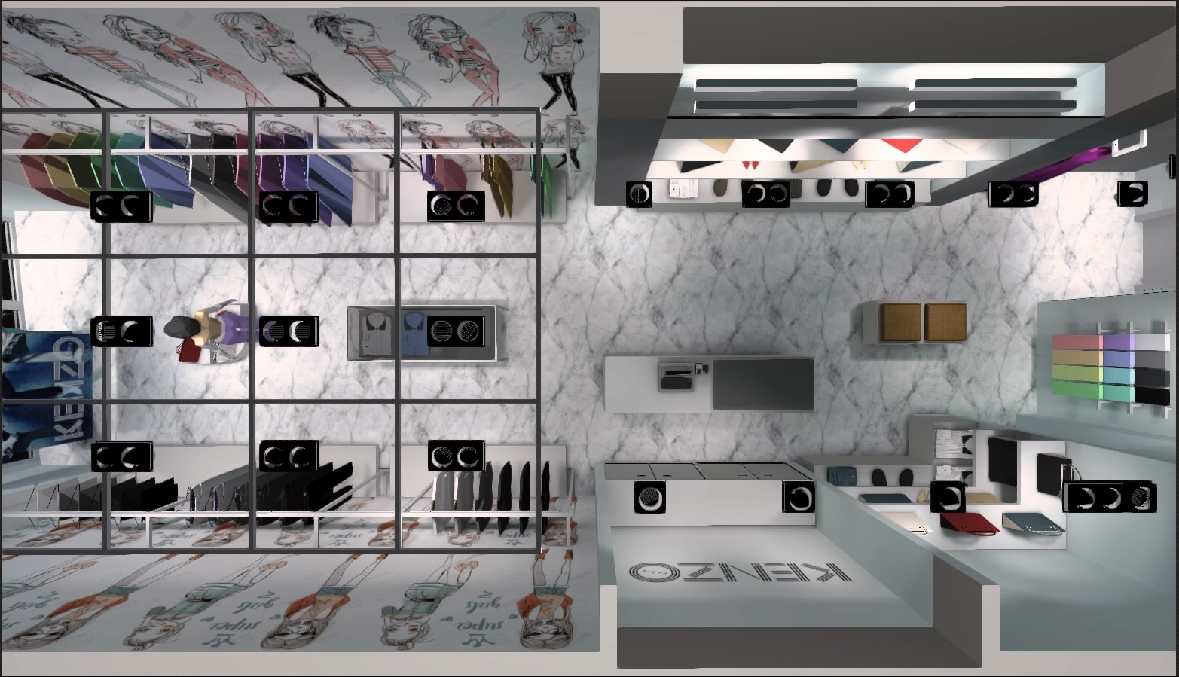
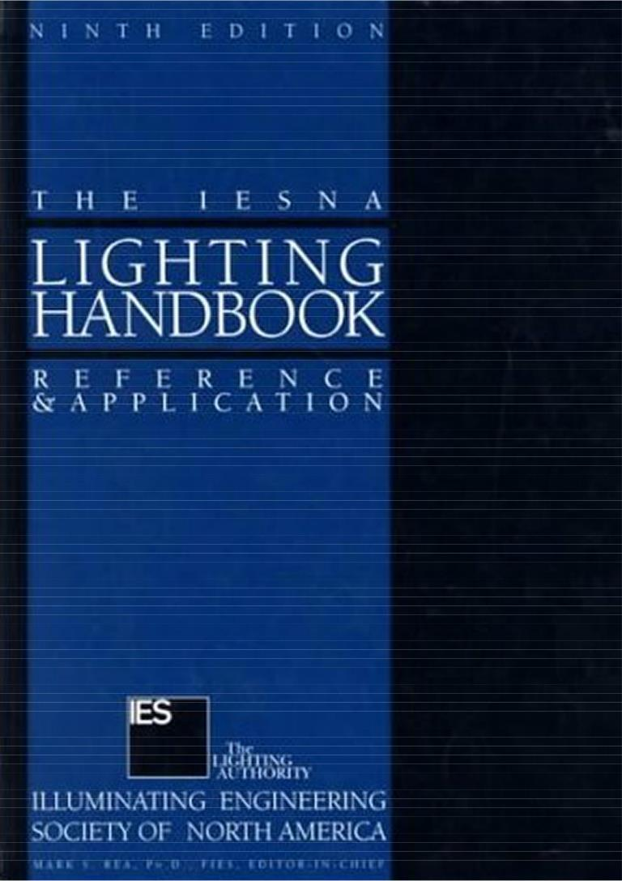
IESNA Lighting Handbook
RETAIL LIGHTING
9th Edition
Nelca Roco
L I G H T I N G D E S I G N S

Slide 2
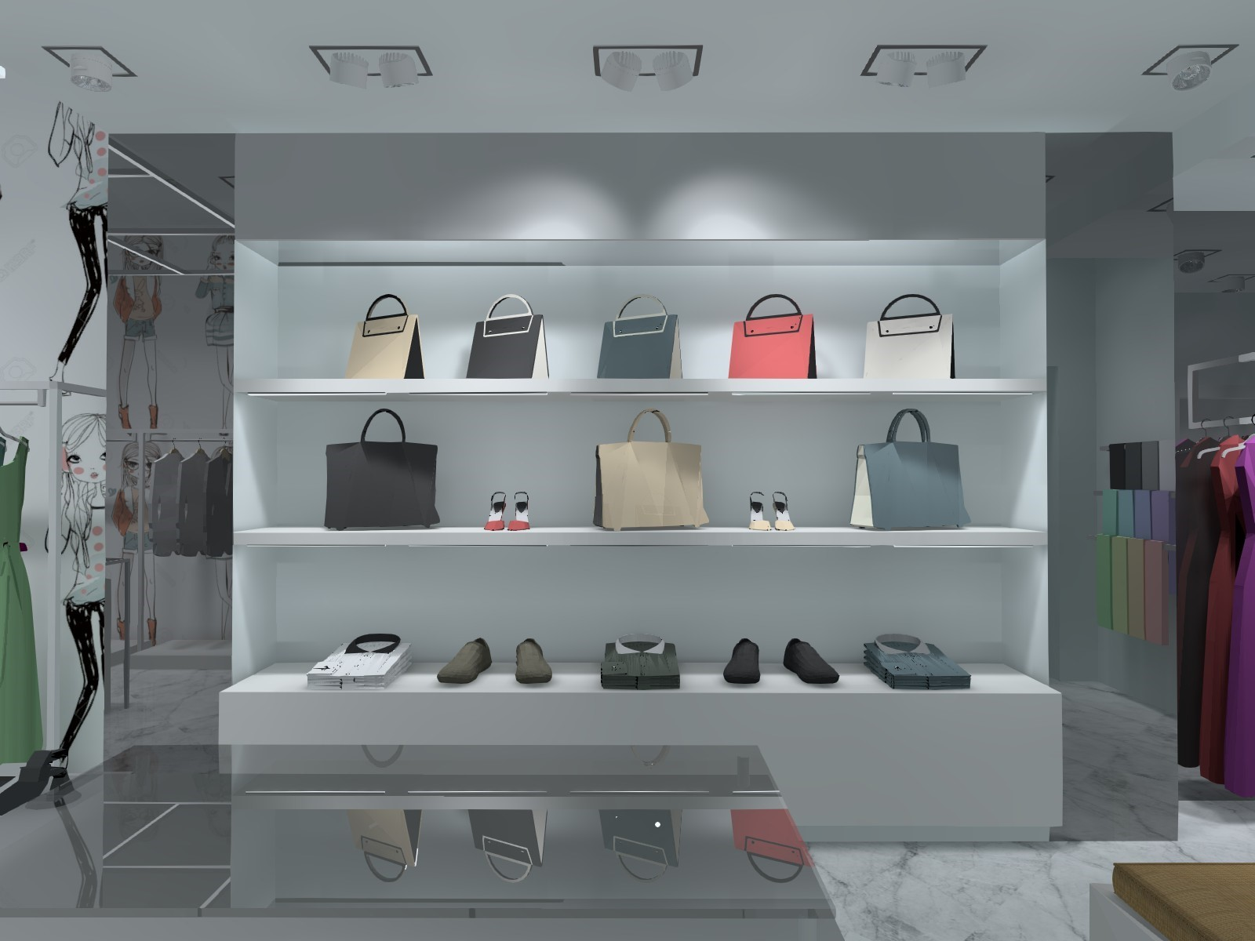
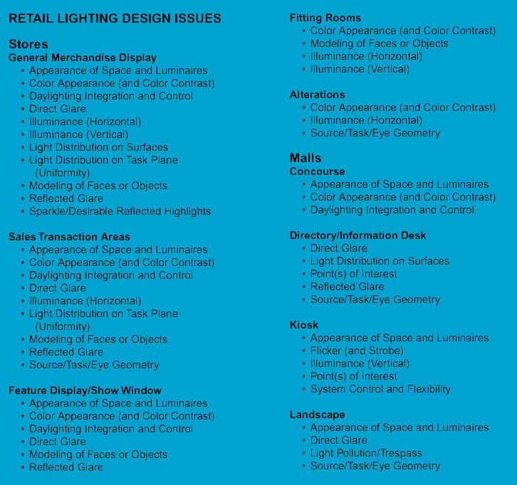
RETAIL LIGHTING DESIGN
Retail Lighting Design Issues
General merchandise display
Sales transaction areas
Feature display/ Shop window
Fitting rooms
Alterations

Slide 3
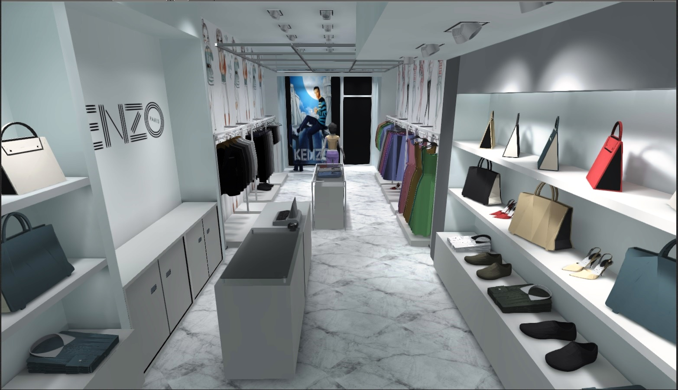
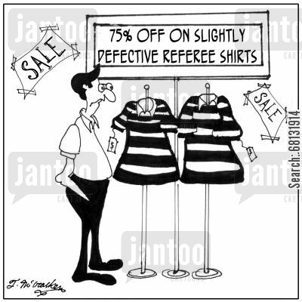
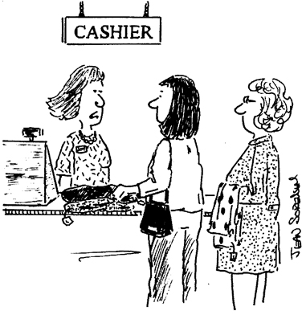
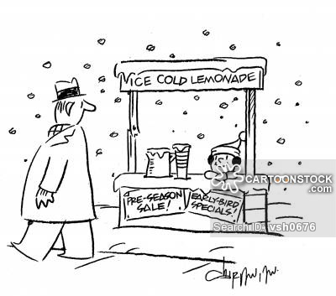
RETAIL LIGHTING DESIGN
Goals of Retail Lighting
Lighting Should Attract the Customer
Lighting Should Allow the Customer to Evaluate the Merchandise
Lighting Should Facilitate the Completion of the Sale
Notes:
Lighting is an important part of a total shop concept; it can evoke feelings, strengthen your brand and effect sales. Our mission is to use lighting as a tool to enhance the shopping experience.
We feel passionate about retail lighting and can cover the entire spectrum of your lighting project – with high-quality products, education, concept development, on demand design, light planning, aiming and, crucially, on-going maintenance.

Slide 4
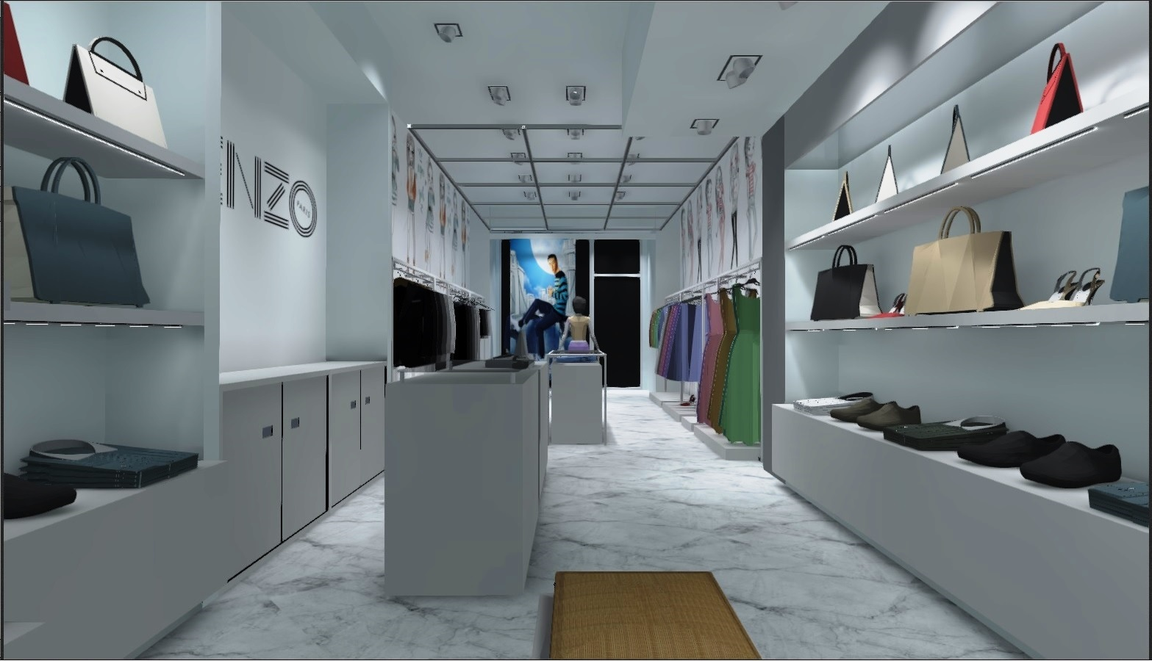
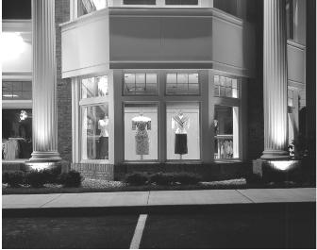
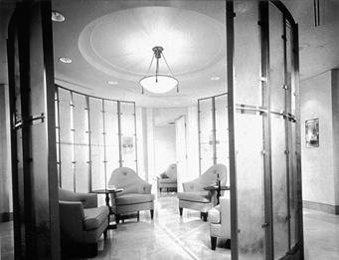
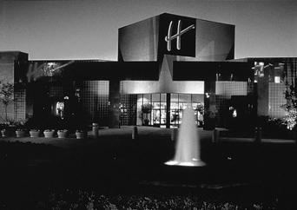
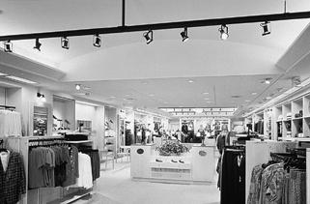
RETAIL LIGHTING DESIGN
Lighting Design Considerations
Sales Areas
Show Windows
Ancillary Spaces
Exterior Spaces
Notes:
Lighting is an important part of a total shop concept; it can evoke feelings, strengthen your brand and effect sales. Our mission is to use lighting as a tool to enhance the shopping experience.
We feel passionate about retail lighting and can cover the entire spectrum of your lighting project – with high-quality products, education, concept development, on demand design, light planning, aiming and, crucially, on-going maintenance.

Slide 5
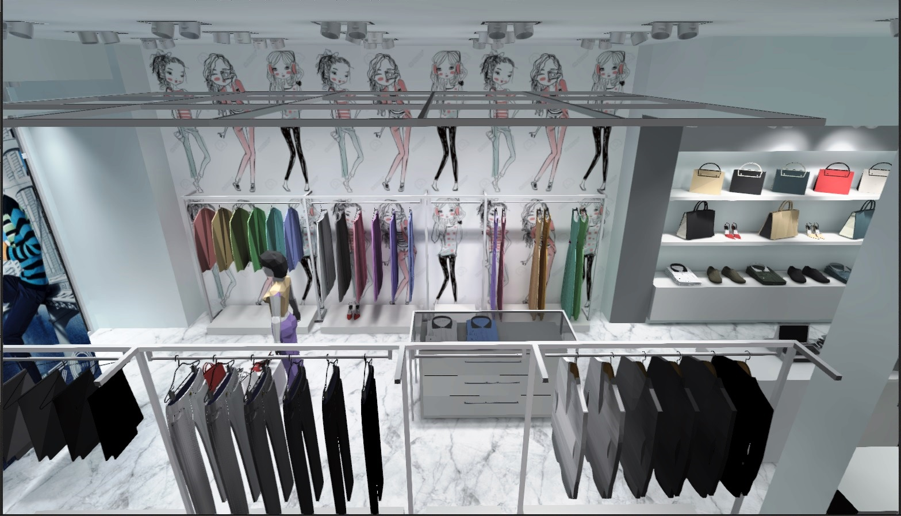
RETAIL LIGHTING DESIGN
Lighting Design Considerations
Sales Areas
Show Windows
Ancillary Spaces
Exterior Spaces
Type and characteristics of merchandise
Merchandising strategies
Location of each merchandising area within the store and at outdoor areas
General illuminance level
Illuminance levels of adjacent spaces
Feature and display illuminance levels
Size and shape of space
Surface reflectances, colors, and textures
Flexibility requirements
Size and location of graphics
Method of display (racks, gondolas, and counters)
Method and location of sales transactions
Location of merchandise displays including feature displays
Traffic patterns
Notes:
Lighting is an important part of a total shop concept; it can evoke feelings, strengthen your brand and effect sales. Our mission is to use lighting as a tool to enhance the shopping experience.
We feel passionate about retail lighting and can cover the entire spectrum of your lighting project – with high-quality products, education, concept development, on demand design, light planning, aiming and, crucially, on-going maintenance.

Slide 6
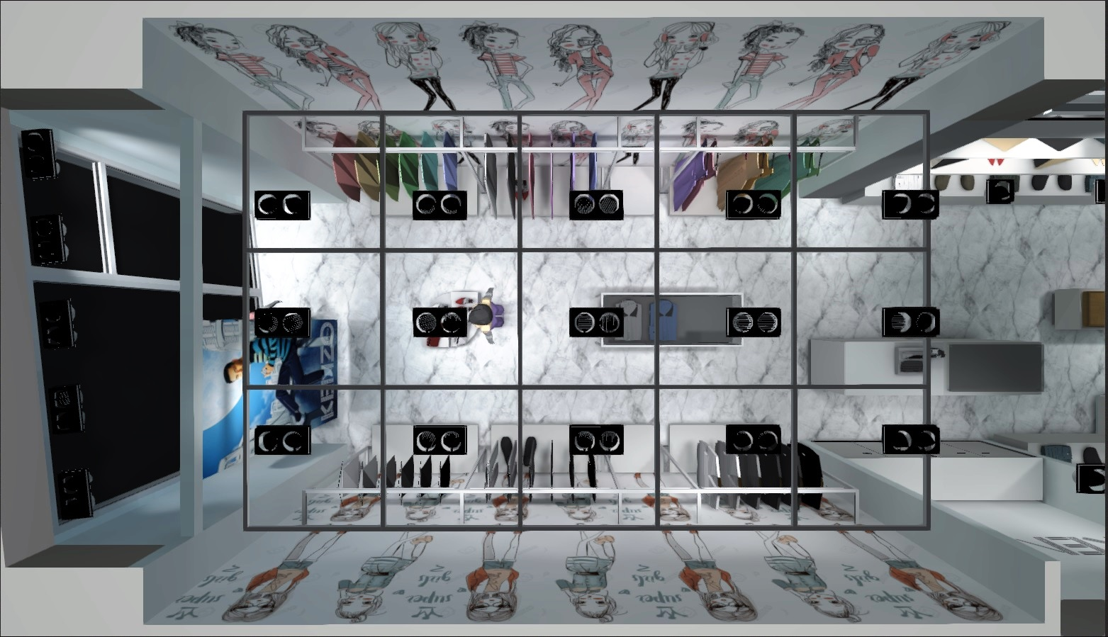
RETAIL LIGHTING DESIGN
Lighting Design Considerations
Sales Areas
Show Windows
Ancillary Spaces
Exterior Spaces
Location of show window (outdoor or enclosed mall area, urban or suburban, solo or shopping center)
Night and day use and associated ambient illuminances
The nature of the overall competition as well as adjacent show windows
Fully enclosed or open back configuration
Size and shape
Reflections, contour, and slant of show window glazing
Architectural canopies, jalousies, or louvers
Interior surface reflectances and colors
Size and location of display graphics
Notes:
Lighting is an important part of a total shop concept; it can evoke feelings, strengthen your brand and effect sales. Our mission is to use lighting as a tool to enhance the shopping experience.
We feel passionate about retail lighting and can cover the entire spectrum of your lighting project – with high-quality products, education, concept development, on demand design, light planning, aiming and, crucially, on-going maintenance.

Slide 7
RETAIL LIGHTING DESIGN
Lighting Design Considerations
Sales Areas
Show Windows
Ancillary Spaces
Exterior Spaces
Dressing and Fitting Room Lighting
Alteration Workrooms
Wrapping and Packing
Stock Rooms
Restrooms, Lounges, and Locker Rooms
Offices
Notes:
Lighting is an important part of a total shop concept; it can evoke feelings, strengthen your brand and effect sales. Our mission is to use lighting as a tool to enhance the shopping experience.
We feel passionate about retail lighting and can cover the entire spectrum of your lighting project – with high-quality products, education, concept development, on demand design, light planning, aiming and, crucially, on-going maintenance.

Slide 8
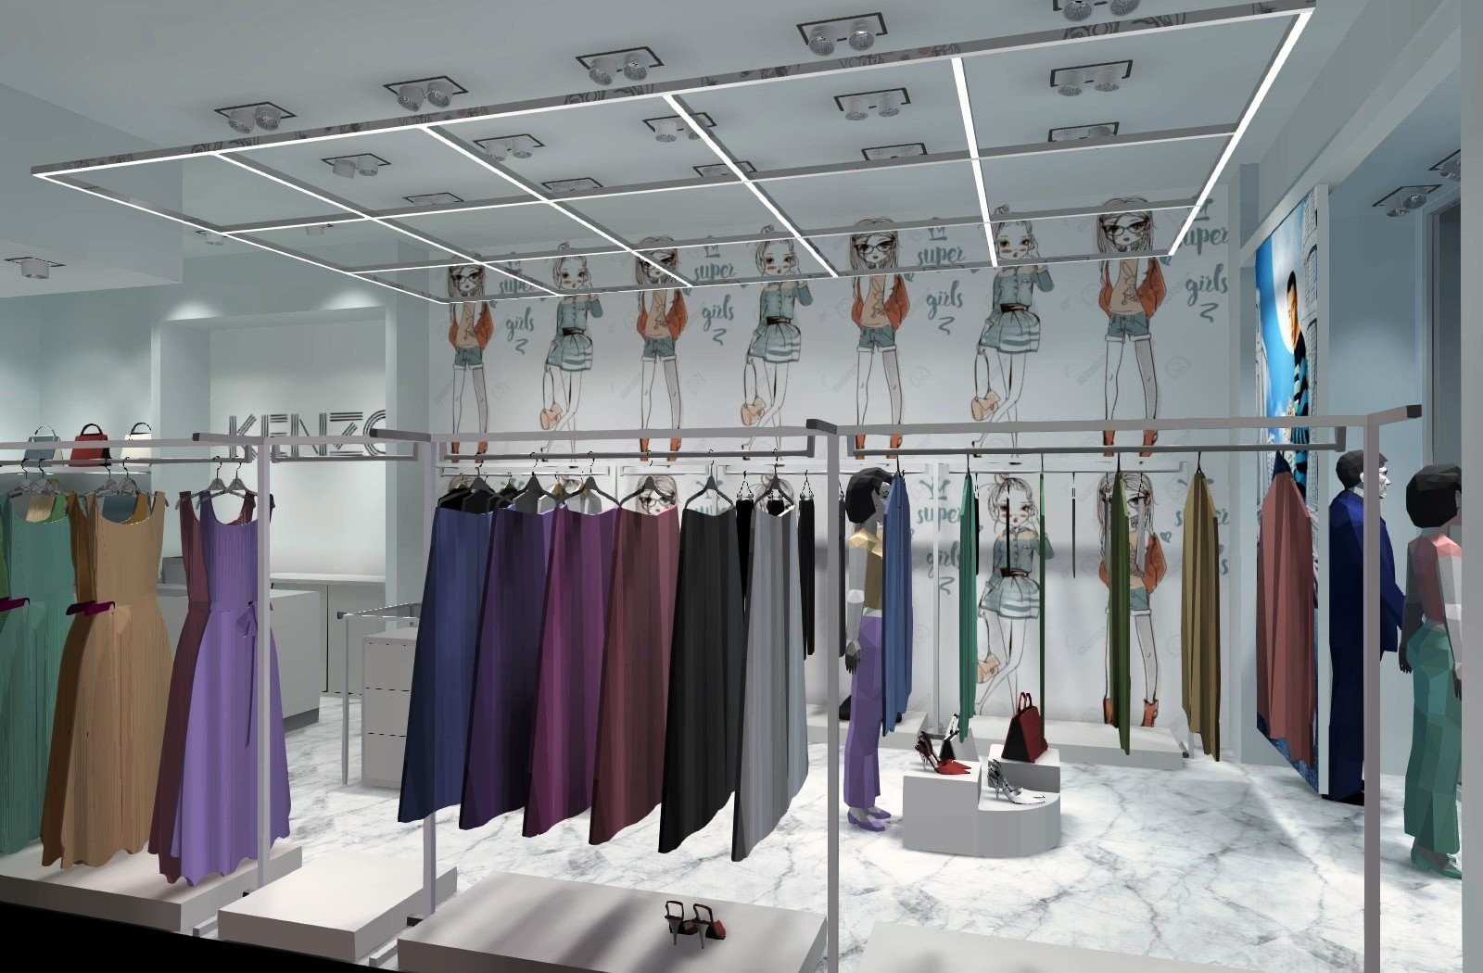
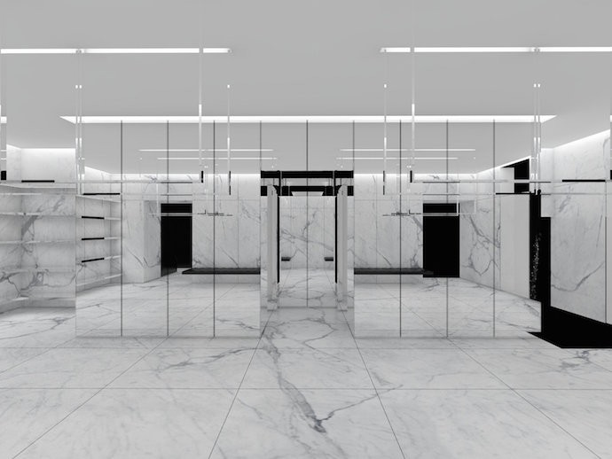
RETAIL LIGHTING DESIGN
Lighting Design Considerations
Sales Areas
Show Windows
Ancillary Spaces
Dressing and Fitting Room Lighting
Alteration Workrooms
Wrapping and Packing
Stock Rooms
Restrooms, Lounges, and Locker Rooms
Offices
Exterior Spaces
Notes:
Lighting is an important part of a total shop concept; it can evoke feelings, strengthen your brand and effect sales. Our mission is to use lighting as a tool to enhance the shopping experience.
We feel passionate about retail lighting and can cover the entire spectrum of your lighting project – with high-quality products, education, concept development, on demand design, light planning, aiming and, crucially, on-going maintenance.

Slide 9
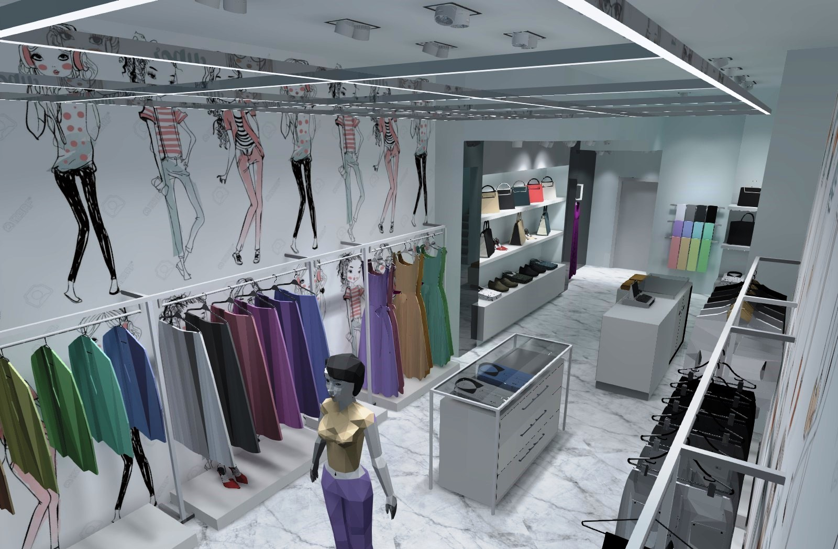
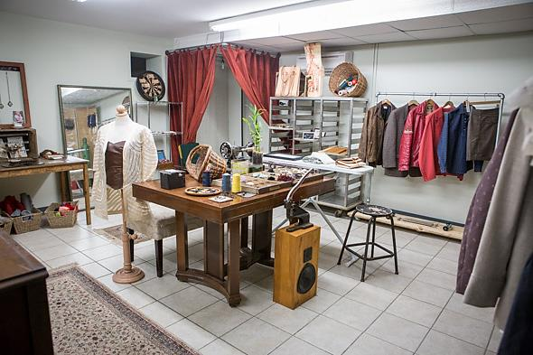
RETAIL LIGHTING DESIGN
Lighting Design Considerations
Sales Areas
Show Windows
Ancillary Spaces
Dressing and Fitting Room Lighting
Alteration Workrooms
Wrapping and Packing
Stock Rooms
Restrooms, Lounges, and Locker Rooms
Offices
Exterior Spaces
Notes:
Lighting is an important part of a total shop concept; it can evoke feelings, strengthen your brand and effect sales. Our mission is to use lighting as a tool to enhance the shopping experience.
We feel passionate about retail lighting and can cover the entire spectrum of your lighting project – with high-quality products, education, concept development, on demand design, light planning, aiming and, crucially, on-going maintenance.

Slide 10
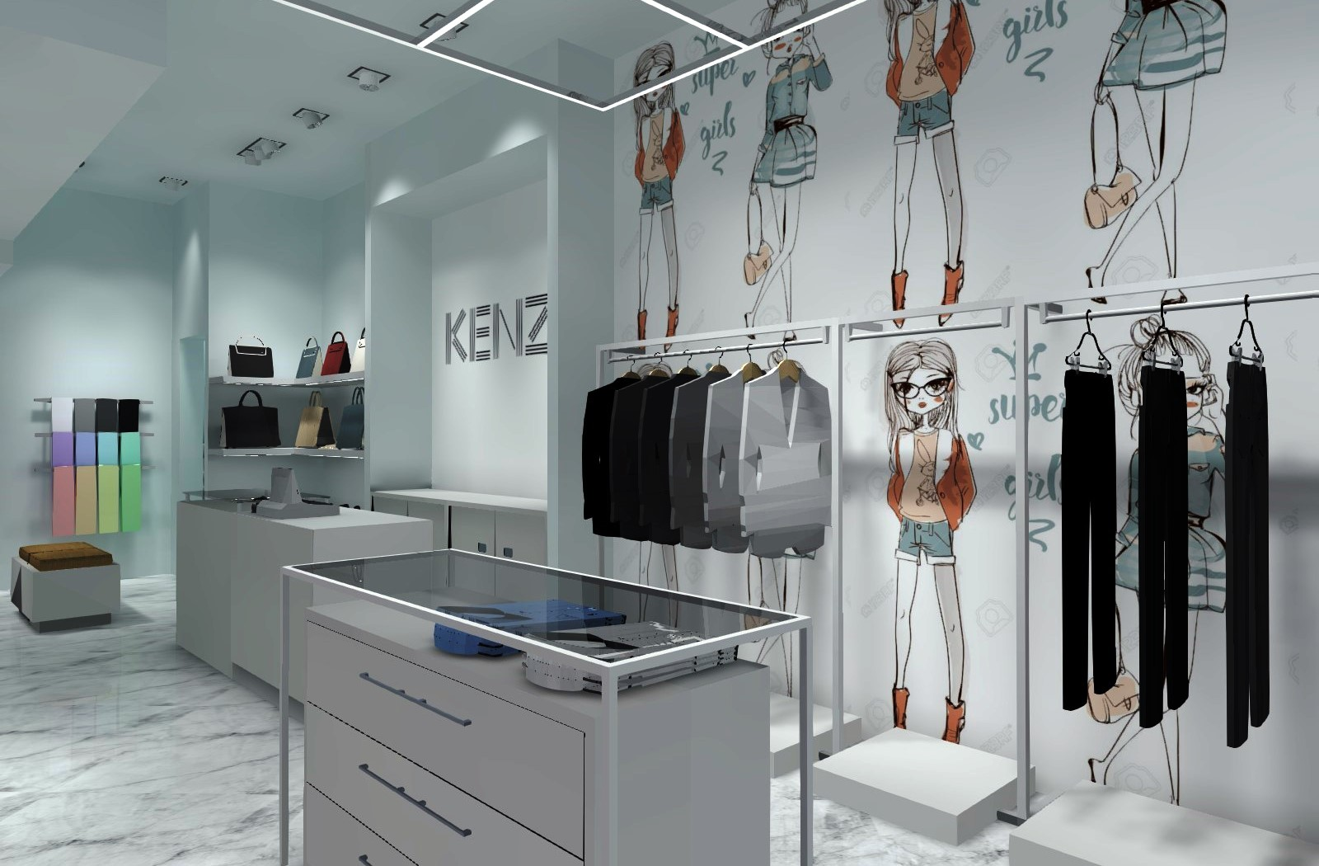
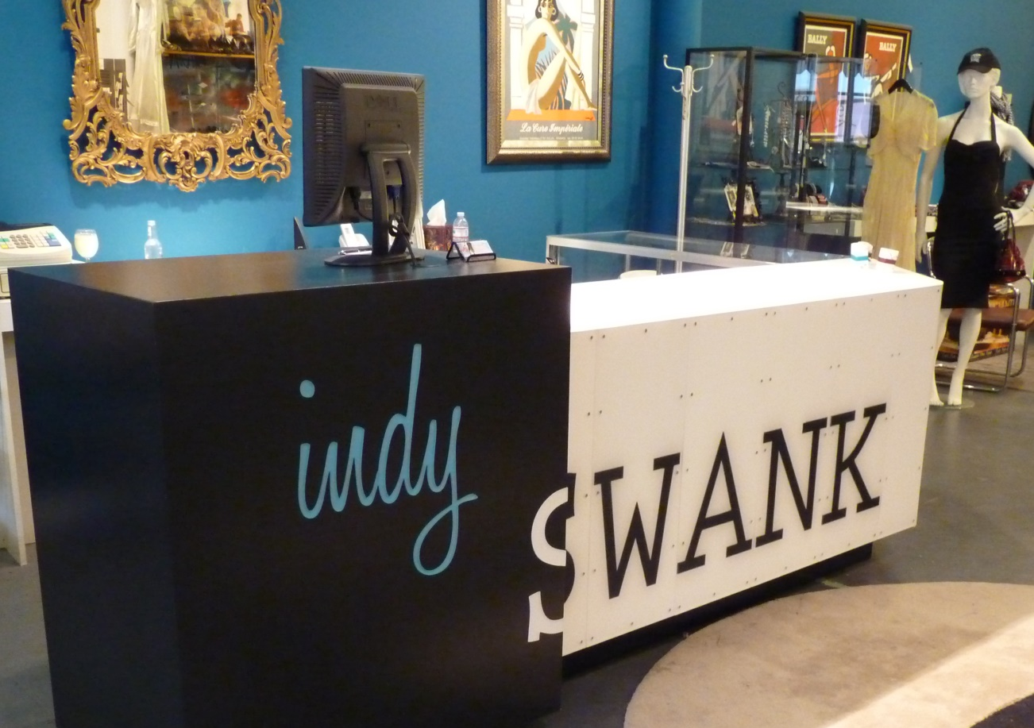
RETAIL LIGHTING DESIGN
Lighting Design Considerations
Sales Areas
Show Windows
Ancillary Spaces
Dressing and Fitting Room Lighting
Alteration Workrooms
Wrapping and Packing
Stock Rooms
Restrooms, Lounges, and Locker Rooms
Offices
Exterior Spaces
Notes:
Lighting is an important part of a total shop concept; it can evoke feelings, strengthen your brand and effect sales. Our mission is to use lighting as a tool to enhance the shopping experience.
We feel passionate about retail lighting and can cover the entire spectrum of your lighting project – with high-quality products, education, concept development, on demand design, light planning, aiming and, crucially, on-going maintenance.

Slide 11
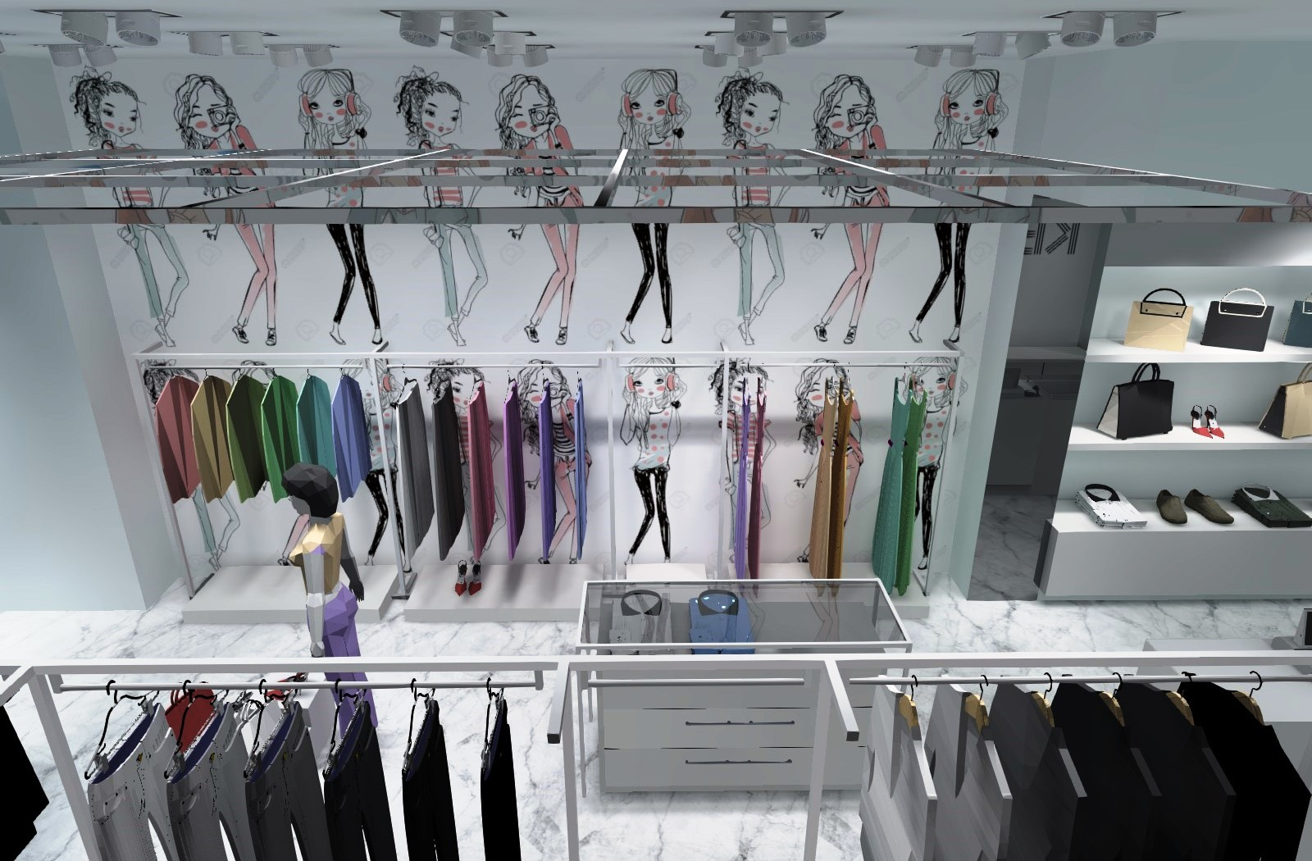
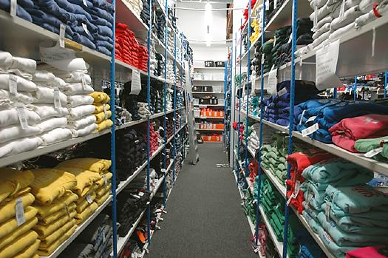
RETAIL LIGHTING DESIGN
Lighting Design Considerations
Sales Areas
Show Windows
Ancillary Spaces
Dressing and Fitting Room Lighting
Alteration Workrooms
Wrapping and Packing
Stock Rooms
Restrooms, Lounges, and Locker Rooms
Offices
Exterior Spaces
Notes:
Lighting is an important part of a total shop concept; it can evoke feelings, strengthen your brand and effect sales. Our mission is to use lighting as a tool to enhance the shopping experience.
We feel passionate about retail lighting and can cover the entire spectrum of your lighting project – with high-quality products, education, concept development, on demand design, light planning, aiming and, crucially, on-going maintenance.

Slide 12
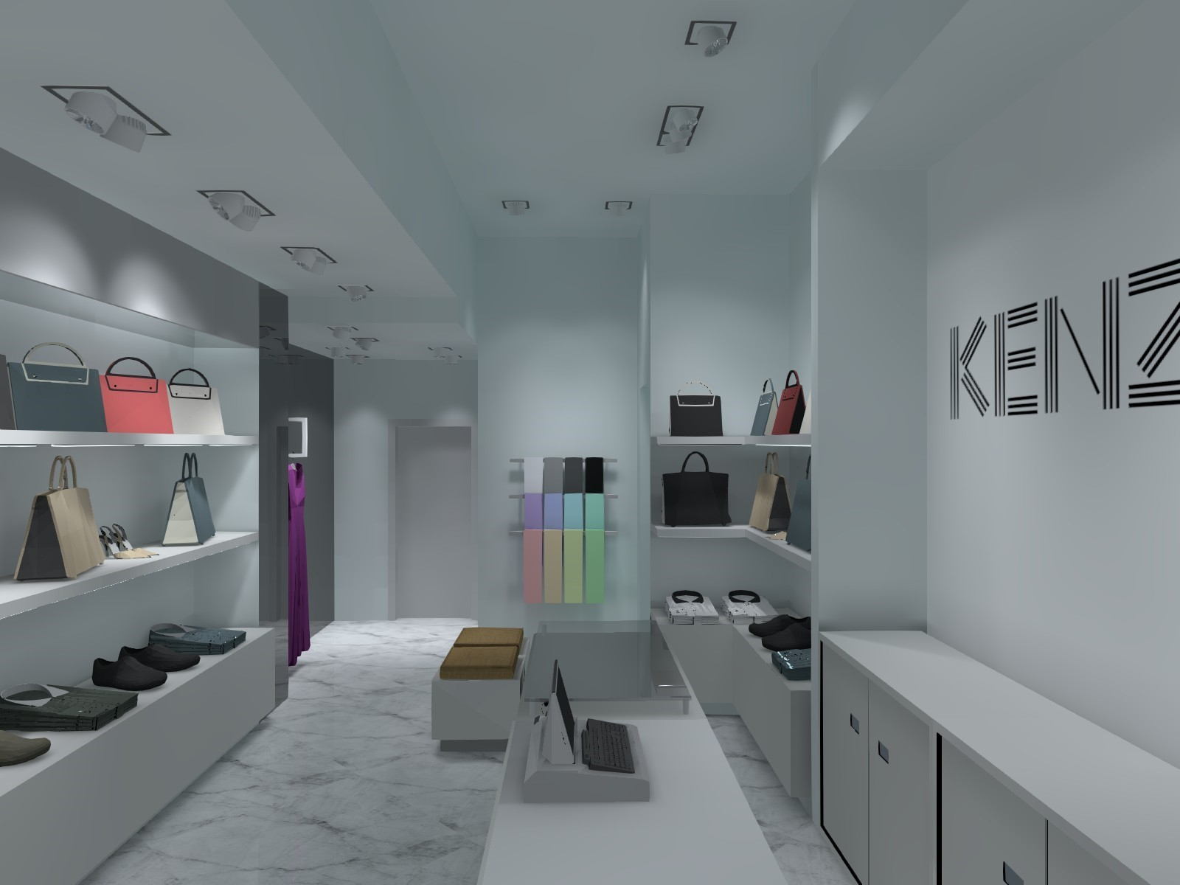
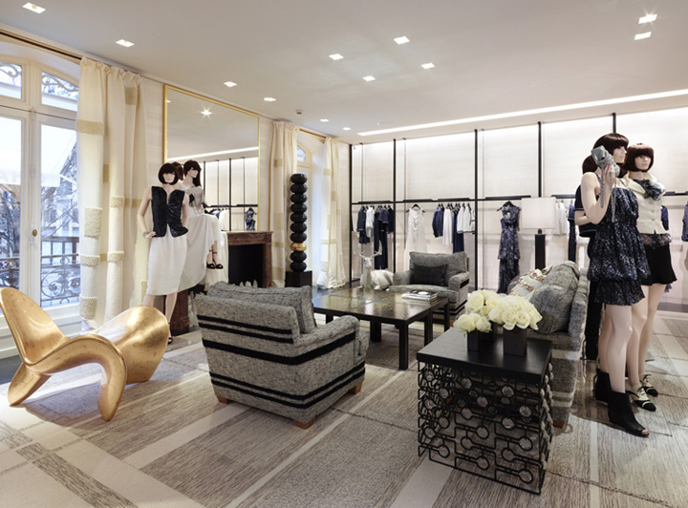
RETAIL LIGHTING DESIGN
Lighting Design Considerations
Sales Areas
Show Windows
Ancillary Spaces
Dressing and Fitting Room Lighting
Alteration Workrooms
Wrapping and Packing
Stock Rooms
Restrooms, Lounges, and Locker Rooms
Offices
Exterior Spaces
Notes:
Lighting is an important part of a total shop concept; it can evoke feelings, strengthen your brand and effect sales. Our mission is to use lighting as a tool to enhance the shopping experience.
We feel passionate about retail lighting and can cover the entire spectrum of your lighting project – with high-quality products, education, concept development, on demand design, light planning, aiming and, crucially, on-going maintenance.

Slide 13
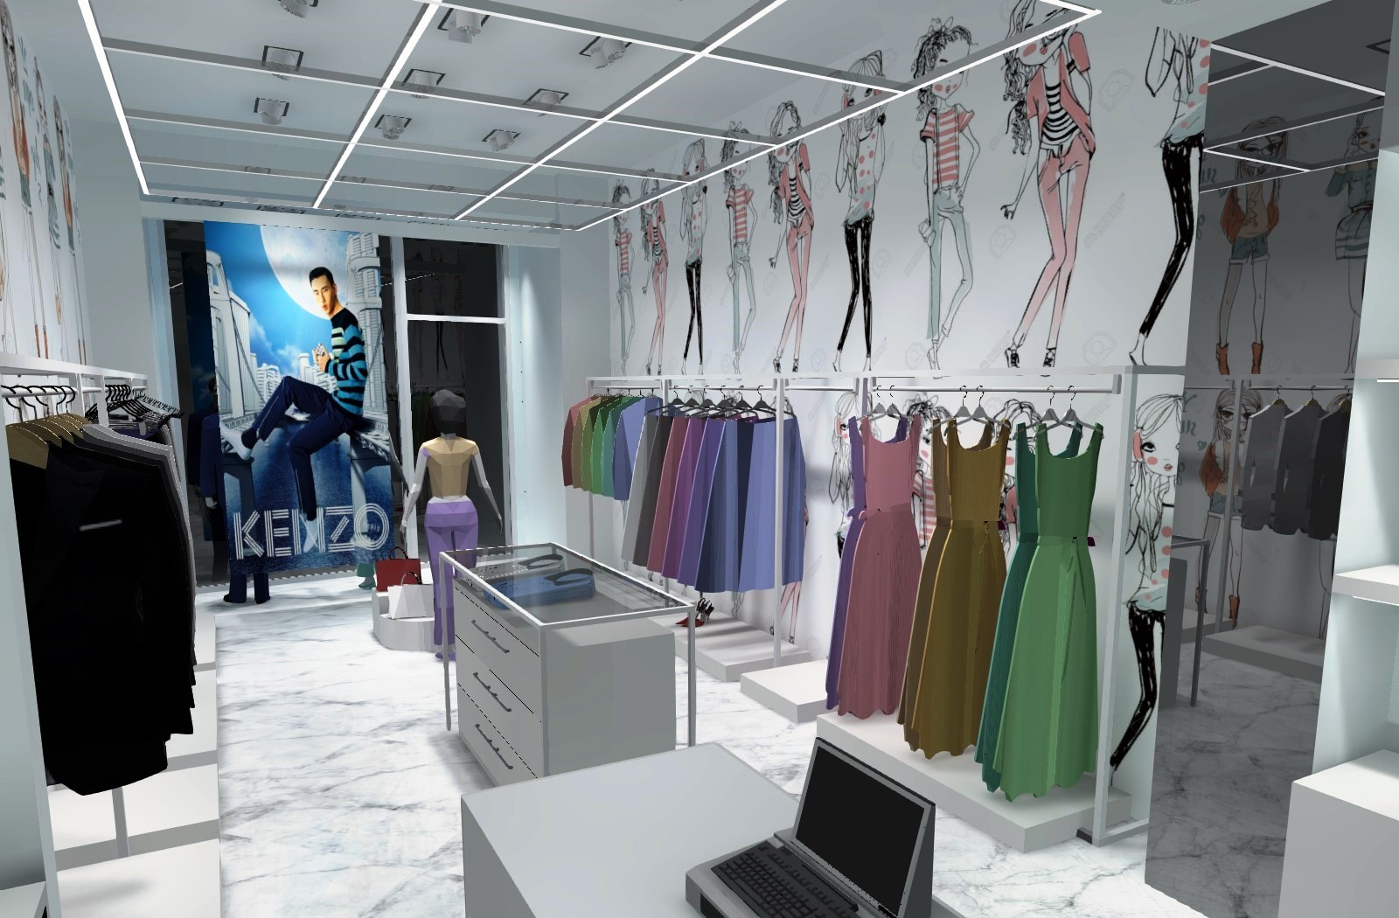
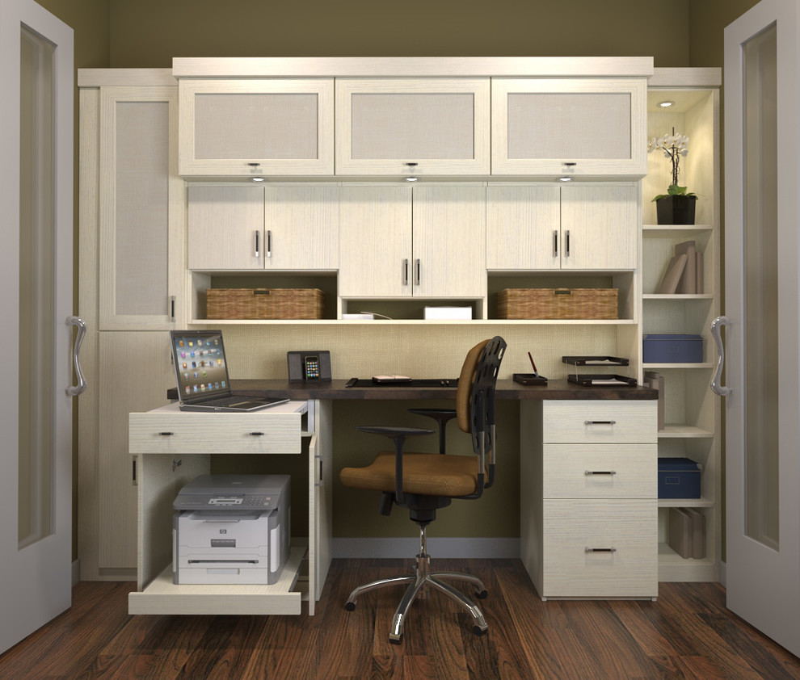
RETAIL LIGHTING DESIGN
Lighting Design Considerations
Sales Areas
Show Windows
Ancillary Spaces
Dressing and Fitting Room Lighting
Alteration Workrooms
Wrapping and Packing
Stock Rooms
Restrooms, Lounges, and Locker Rooms
Offices
Exterior Spaces
Notes:
Lighting is an important part of a total shop concept; it can evoke feelings, strengthen your brand and effect sales. Our mission is to use lighting as a tool to enhance the shopping experience.
We feel passionate about retail lighting and can cover the entire spectrum of your lighting project – with high-quality products, education, concept development, on demand design, light planning, aiming and, crucially, on-going maintenance.

Slide 14
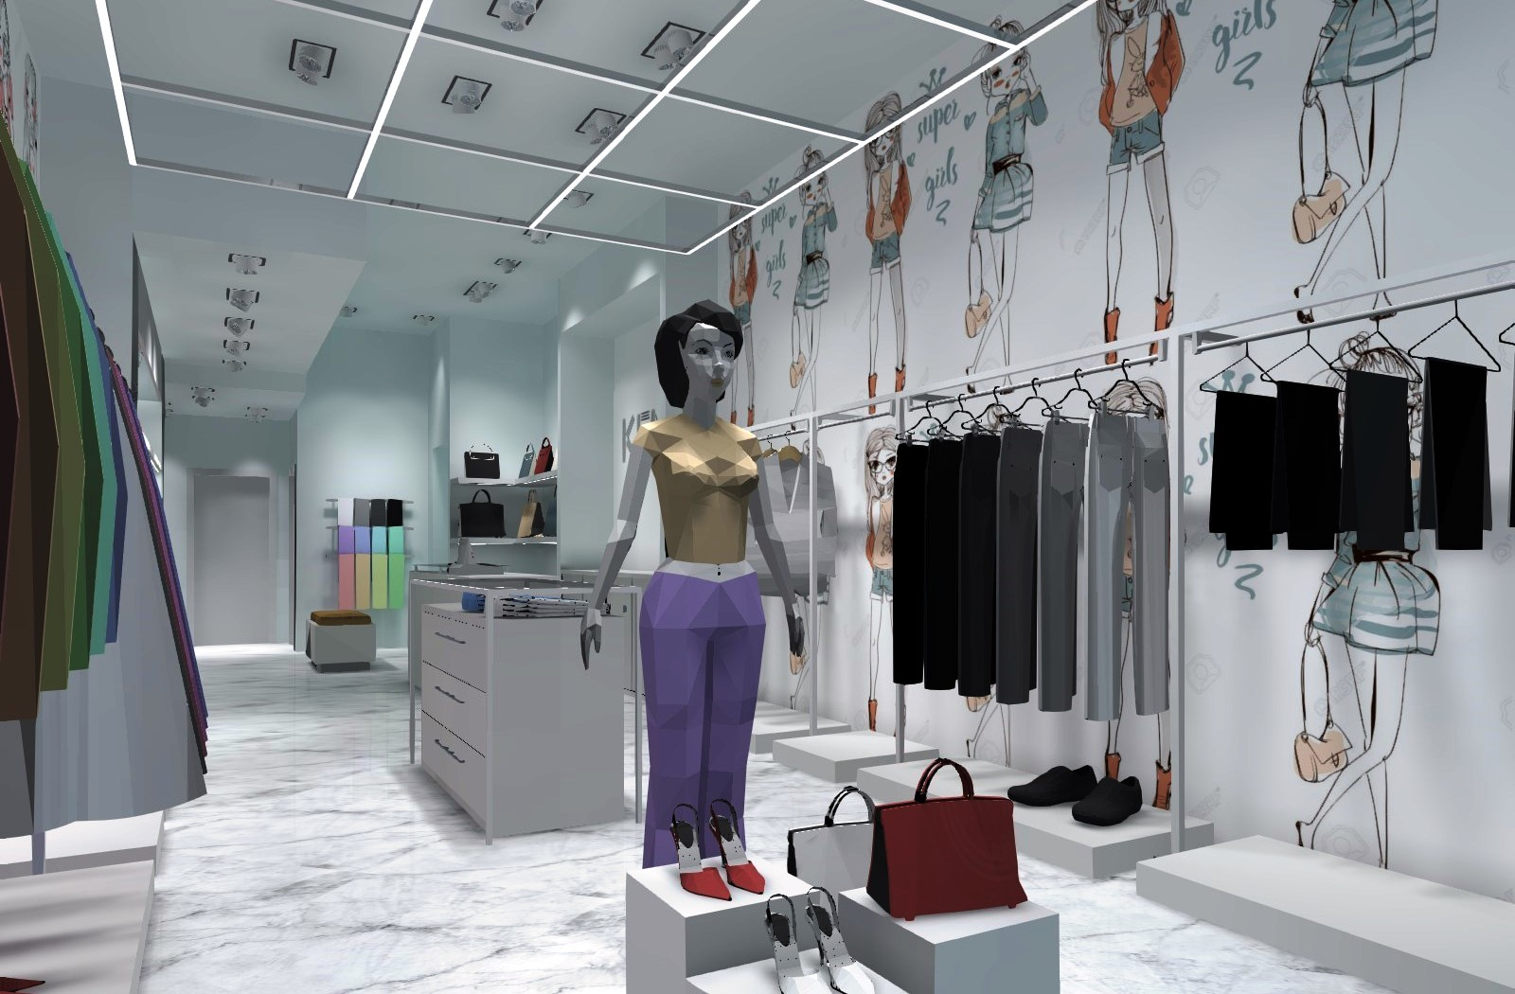
RETAIL LIGHTING DESIGN
Lighting Design Considerations
Sales Areas
Show Windows
Ancillary Spaces
Exterior Spaces
Identifying key areas such as entrances, exits, parking facilities, anchor stores, and crosswalks
Facilitating safe passage of motorists and pedestrians on the grounds
Contributing to effective security and surveillance of people and property
Visually unifying the shopping area
Projecting the image and ambiance of the retail establishment
Notes:
Lighting is an important part of a total shop concept; it can evoke feelings, strengthen your brand and effect sales. Our mission is to use lighting as a tool to enhance the shopping experience.
We feel passionate about retail lighting and can cover the entire spectrum of your lighting project – with high-quality products, education, concept development, on demand design, light planning, aiming and, crucially, on-going maintenance.

Slide 15
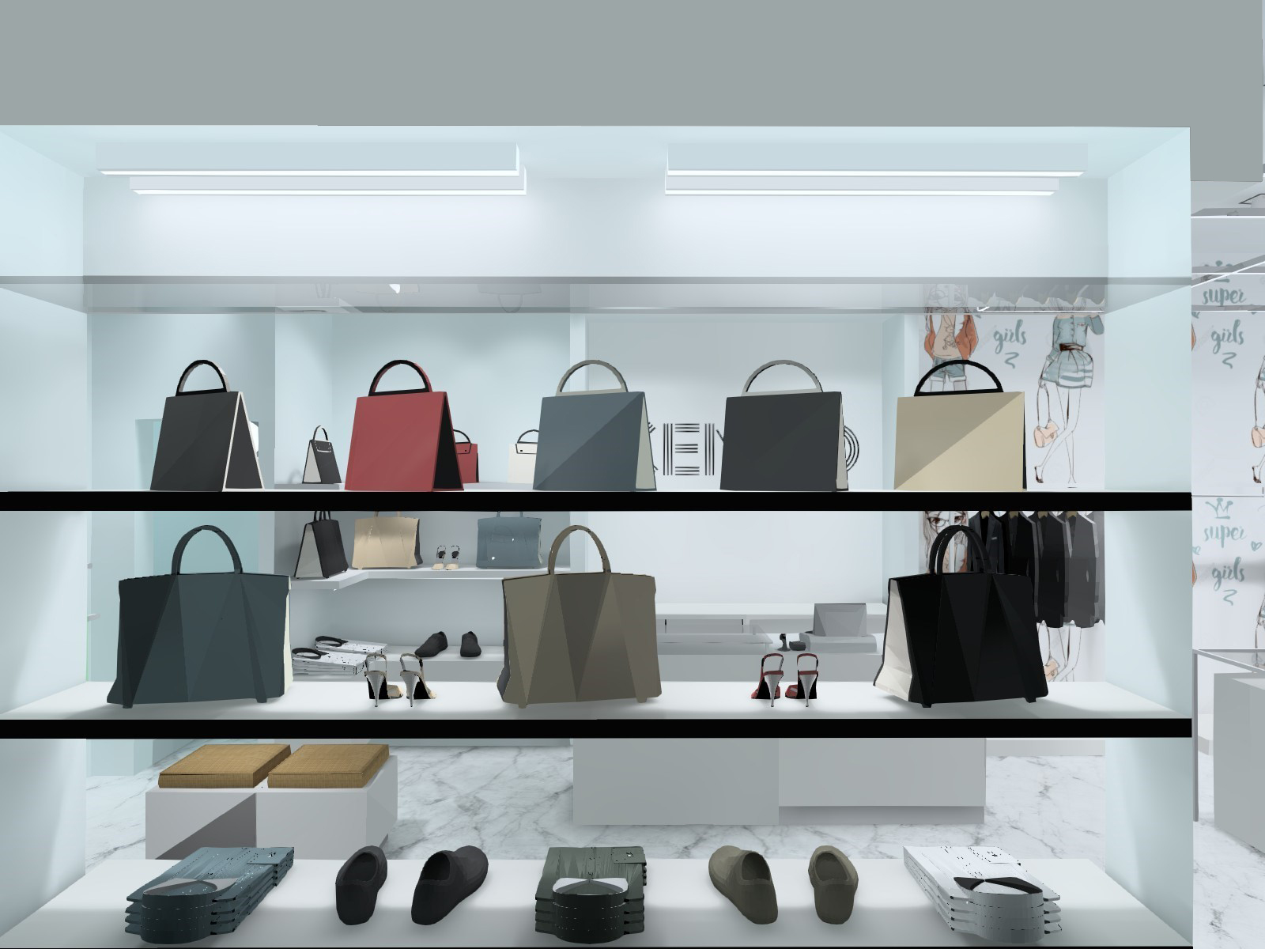
RETAIL LIGHTING DESIGN
Lighting Methods for Retail
Distribution and Direction of Light
Ambient Lighting
Perimeter Lighting
Accent Lighting
Decorative Lighting
Feature and Supplementary Lighting
Notes:
Lighting is an important part of a total shop concept; it can evoke feelings, strengthen your brand and effect sales. Our mission is to use lighting as a tool to enhance the shopping experience.
We feel passionate about retail lighting and can cover the entire spectrum of your lighting project – with high-quality products, education, concept development, on demand design, light planning, aiming and, crucially, on-going maintenance.

Slide 16
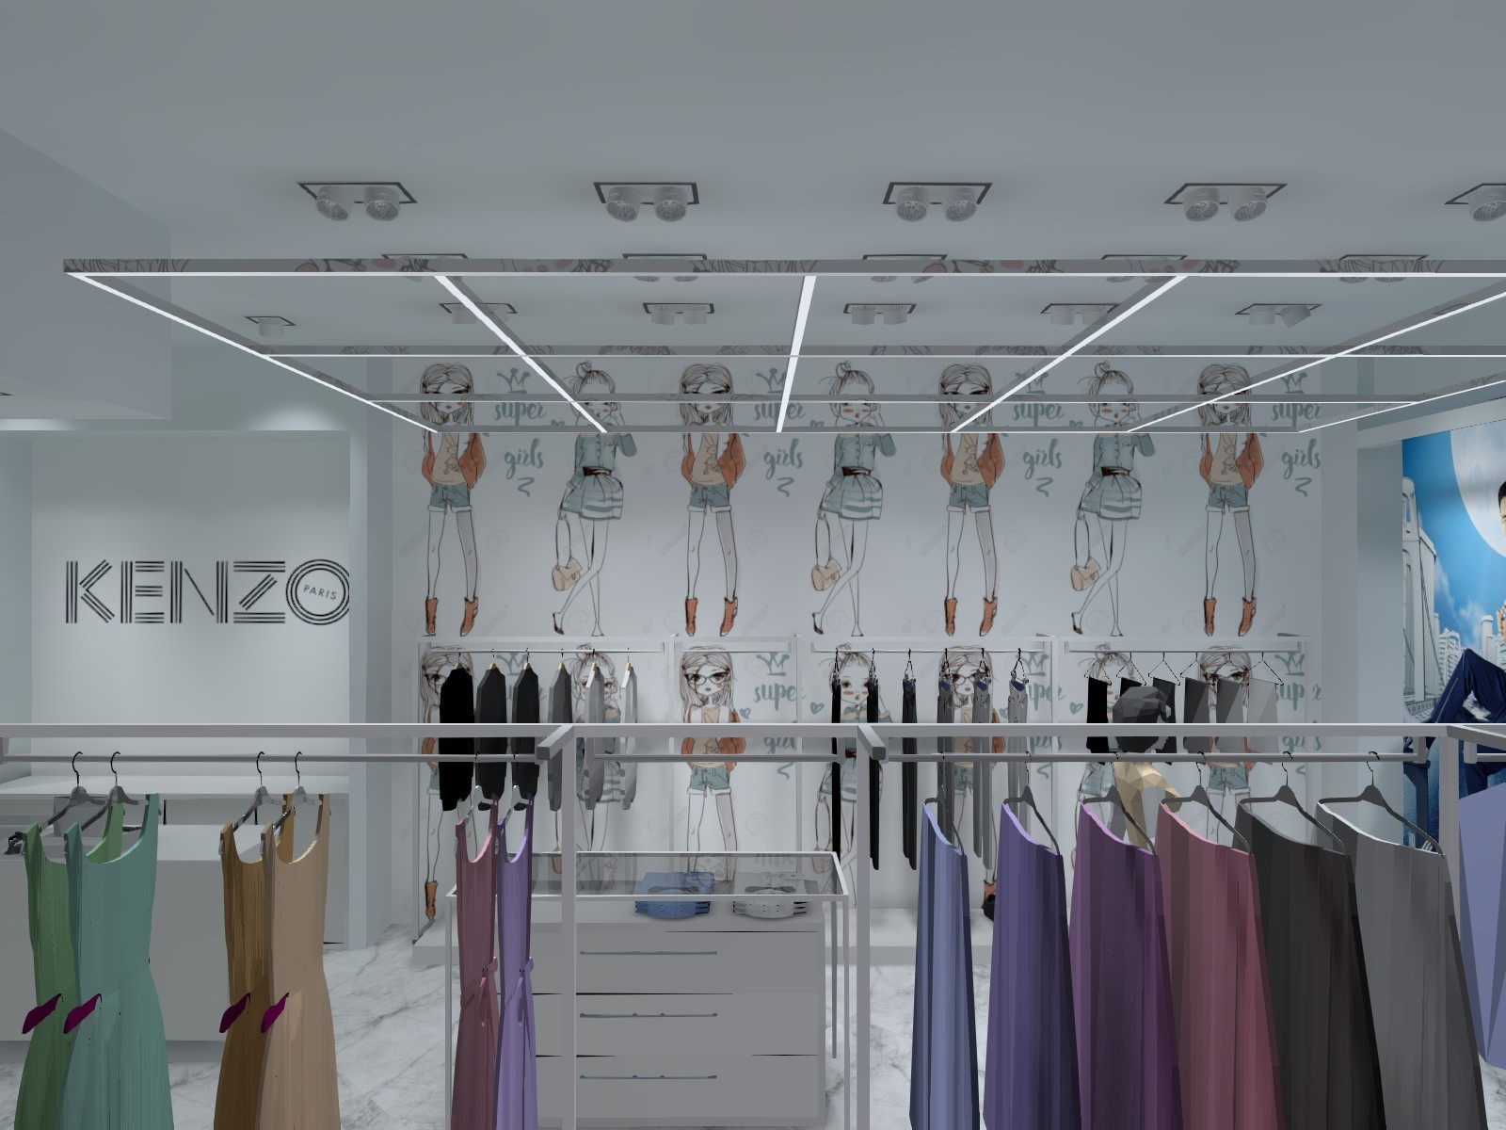
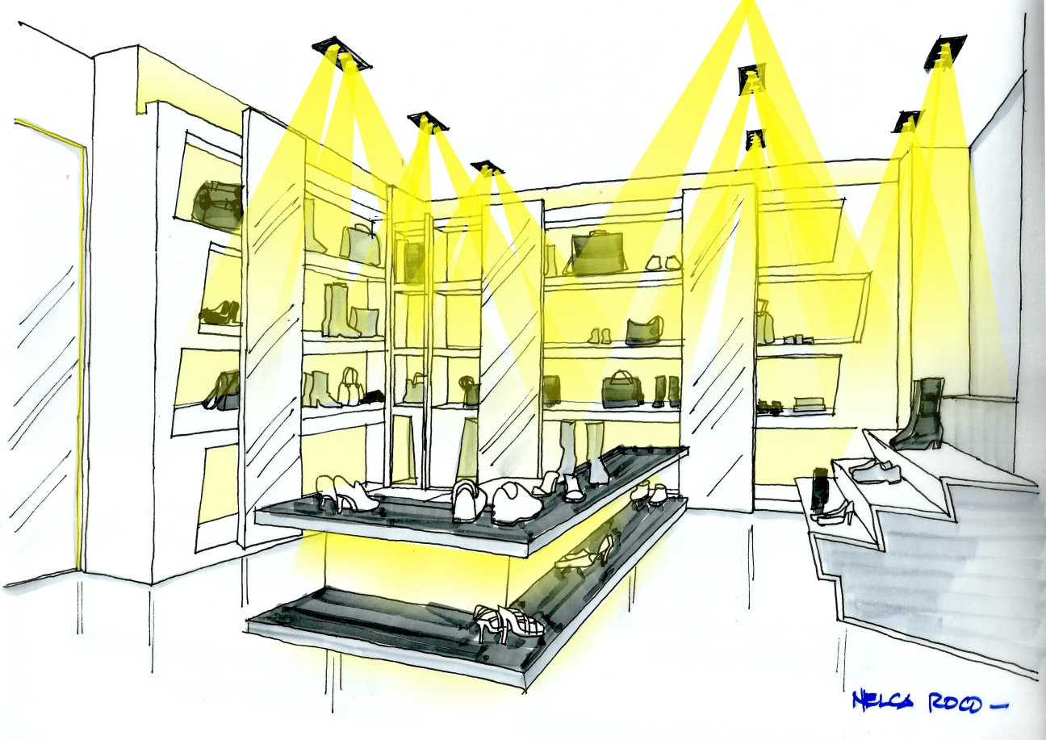
RETAIL LIGHTING DESIGN
Lighting Methods for Retail
Distribution and Direction of Light
Ambient Lighting
Perimeter Lighting
Accent Lighting
Decorative Lighting
Feature and Supplementary Lighting
Notes:
Lighting is an important part of a total shop concept; it can evoke feelings, strengthen your brand and effect sales. Our mission is to use lighting as a tool to enhance the shopping experience.
We feel passionate about retail lighting and can cover the entire spectrum of your lighting project – with high-quality products, education, concept development, on demand design, light planning, aiming and, crucially, on-going maintenance.

Slide 17
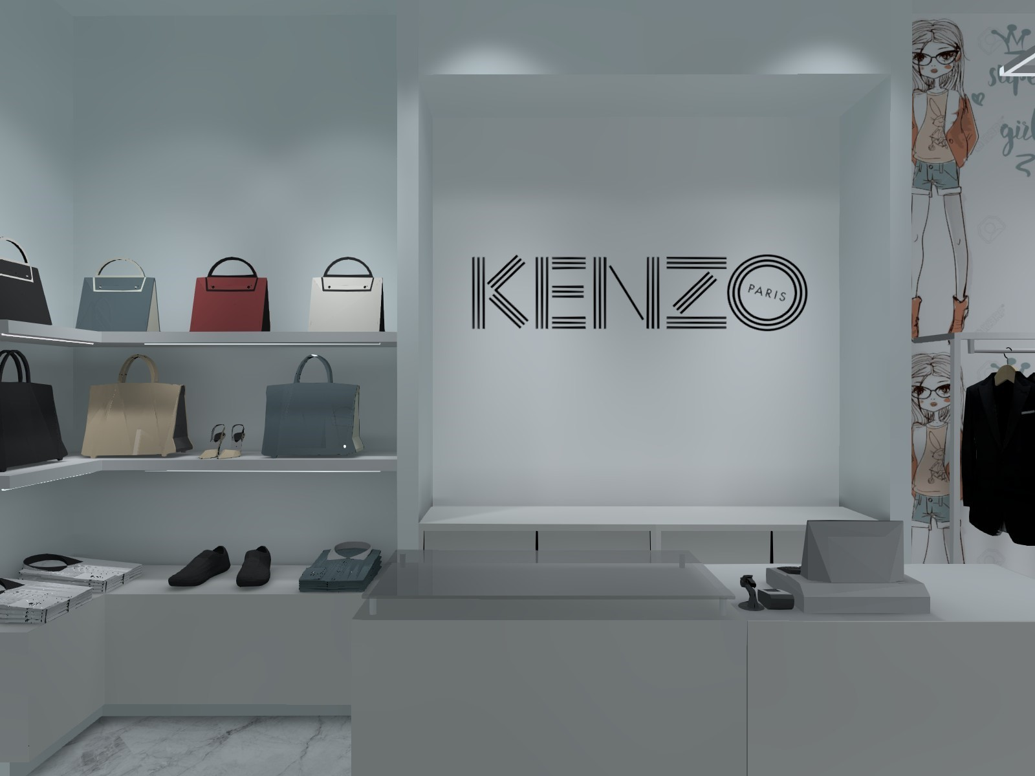
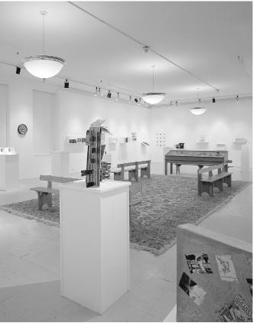
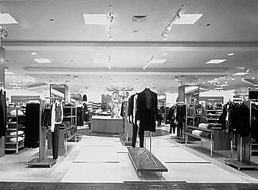
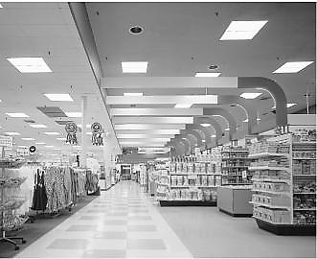
RETAIL LIGHTING DESIGN
Lighting Methods for Retail
Distribution and Direction of Light
Ambient Lighting
Perimeter Lighting
Accent Lighting
Decorative Lighting
Feature and Supplementary Lighting
Notes:
Lighting is an important part of a total shop concept; it can evoke feelings, strengthen your brand and effect sales. Our mission is to use lighting as a tool to enhance the shopping experience.
We feel passionate about retail lighting and can cover the entire spectrum of your lighting project – with high-quality products, education, concept development, on demand design, light planning, aiming and, crucially, on-going maintenance.

Slide 18
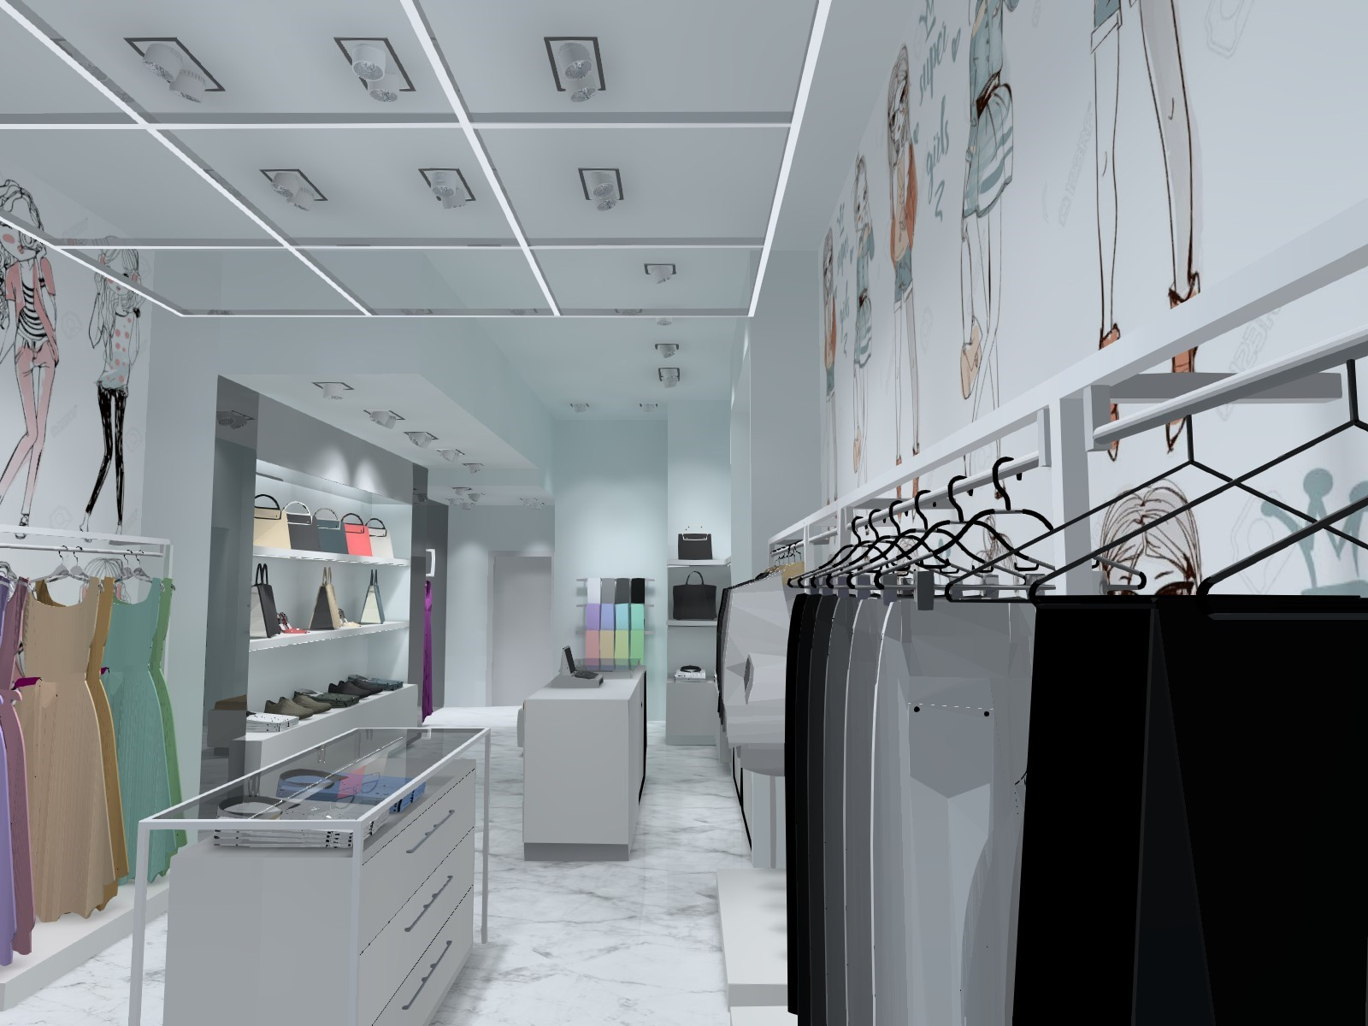
RETAIL LIGHTING DESIGN
Lighting Methods for Retail
Distribution and Direction of Light
Ambient Lighting
1. General Pattern
2. Specific Pattern
3. Flexible Pattern
Perimeter Lighting
Accent Lighting
Decorative Lighting
Feature and Supplementary Lighting
Notes:
Lighting is an important part of a total shop concept; it can evoke feelings, strengthen your brand and effect sales. Our mission is to use lighting as a tool to enhance the shopping experience.
We feel passionate about retail lighting and can cover the entire spectrum of your lighting project – with high-quality products, education, concept development, on demand design, light planning, aiming and, crucially, on-going maintenance.

Slide 19
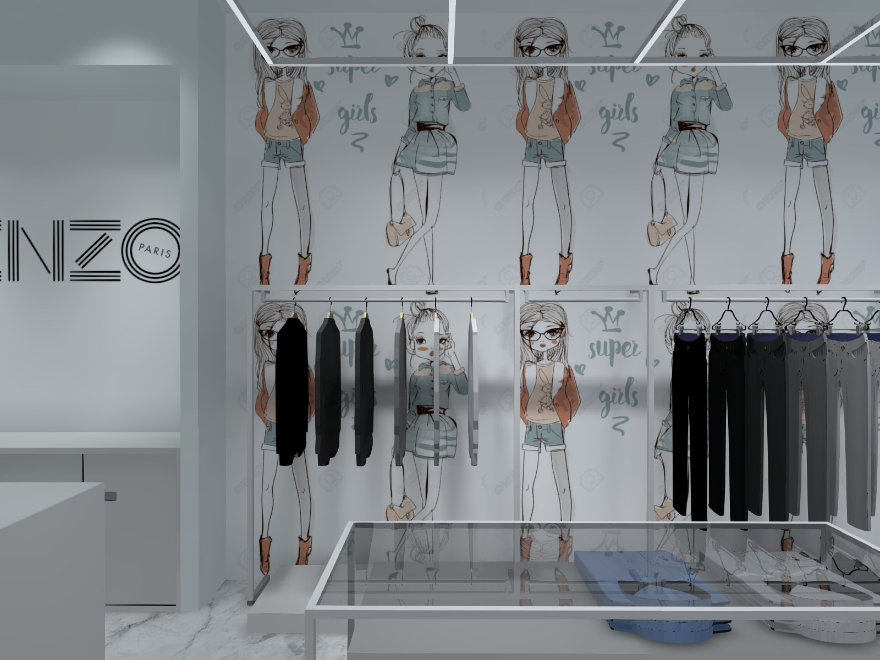
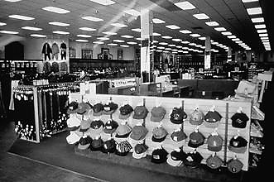
RETAIL LIGHTING DESIGN
Lighting Methods for Retail
Distribution and Direction of Light
Ambient Lighting
1. General Pattern
2. Specific Pattern
3. Flexible Pattern
Perimeter Lighting
Accent Lighting
Decorative Lighting
Feature and Supplementary Lighting
Notes:
Lighting is an important part of a total shop concept; it can evoke feelings, strengthen your brand and effect sales. Our mission is to use lighting as a tool to enhance the shopping experience.
We feel passionate about retail lighting and can cover the entire spectrum of your lighting project – with high-quality products, education, concept development, on demand design, light planning, aiming and, crucially, on-going maintenance.

Slide 20
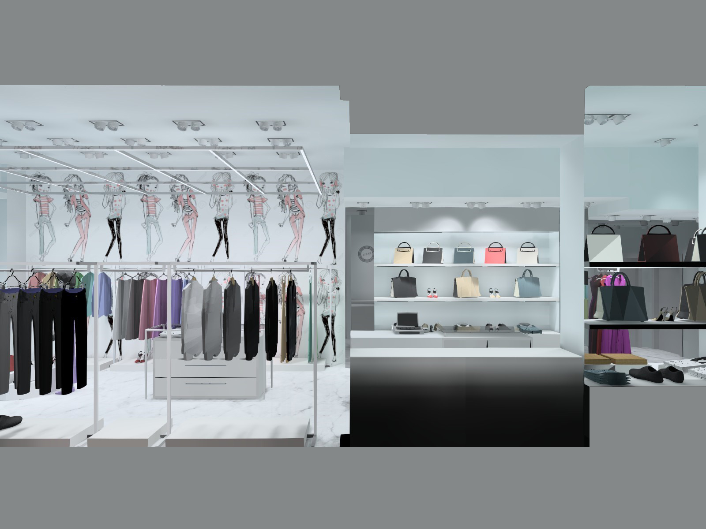
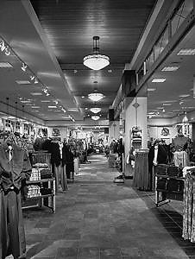
RETAIL LIGHTING DESIGN
Lighting Methods for Retail
Distribution and Direction of Light
Ambient Lighting
1. General Pattern
2. Specific Pattern
3. Flexible Pattern
Perimeter Lighting
Accent Lighting
Decorative Lighting
Feature and Supplementary Lighting
Notes:
Lighting is an important part of a total shop concept; it can evoke feelings, strengthen your brand and effect sales. Our mission is to use lighting as a tool to enhance the shopping experience.
We feel passionate about retail lighting and can cover the entire spectrum of your lighting project – with high-quality products, education, concept development, on demand design, light planning, aiming and, crucially, on-going maintenance.

Slide 21
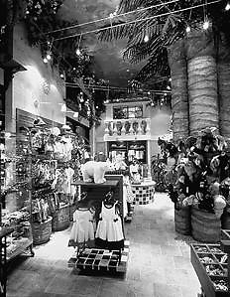
RETAIL LIGHTING DESIGN
Lighting Methods for Retail
Distribution and Direction of Light
Ambient Lighting
1. General Pattern
2. Specific Pattern
3. Flexible Pattern
Perimeter Lighting
Accent Lighting
Decorative Lighting
Feature and Supplementary Lighting
Notes:
Lighting is an important part of a total shop concept; it can evoke feelings, strengthen your brand and effect sales. Our mission is to use lighting as a tool to enhance the shopping experience.
We feel passionate about retail lighting and can cover the entire spectrum of your lighting project – with high-quality products, education, concept development, on demand design, light planning, aiming and, crucially, on-going maintenance.

Slide 22
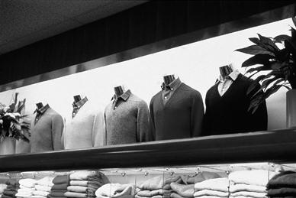
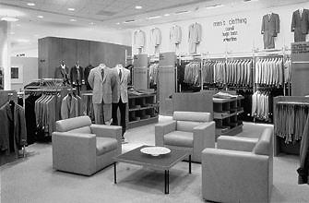
RETAIL LIGHTING DESIGN
Lighting Methods for Retail
Distribution and Direction of Light
Ambient Lighting
Perimeter Lighting
Accent Lighting
Decorative Lighting
Feature and Supplementary Lighting
Notes:
Lighting is an important part of a total shop concept; it can evoke feelings, strengthen your brand and effect sales. Our mission is to use lighting as a tool to enhance the shopping experience.
We feel passionate about retail lighting and can cover the entire spectrum of your lighting project – with high-quality products, education, concept development, on demand design, light planning, aiming and, crucially, on-going maintenance.

Slide 23
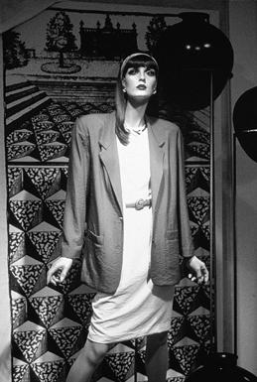
RETAIL LIGHTING DESIGN
Lighting Methods for Retail
Distribution and Direction of Light
Ambient Lighting
Perimeter Lighting
Accent Lighting
Decorative Lighting
Feature and Supplementary Lighting
Notes:
Lighting is an important part of a total shop concept; it can evoke feelings, strengthen your brand and effect sales. Our mission is to use lighting as a tool to enhance the shopping experience.
We feel passionate about retail lighting and can cover the entire spectrum of your lighting project – with high-quality products, education, concept development, on demand design, light planning, aiming and, crucially, on-going maintenance.

Slide 24
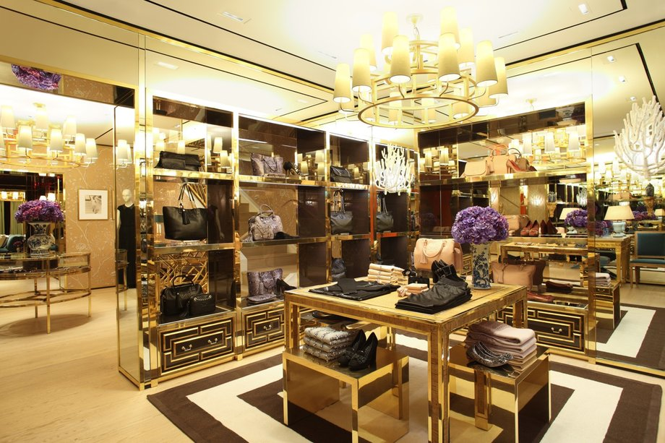
RETAIL LIGHTING DESIGN
Lighting Methods for Retail
Distribution and Direction of Light
Ambient Lighting
Perimeter Lighting
Accent Lighting
Decorative Lighting
Feature and Supplementary Lighting
Notes:
Lighting is an important part of a total shop concept; it can evoke feelings, strengthen your brand and effect sales. Our mission is to use lighting as a tool to enhance the shopping experience.
We feel passionate about retail lighting and can cover the entire spectrum of your lighting project – with high-quality products, education, concept development, on demand design, light planning, aiming and, crucially, on-going maintenance.

Slide 25
RETAIL LIGHTING DESIGN
Lighting Methods for Retail
Distribution and Direction of Light
Ambient Lighting
Perimeter Lighting
Accent Lighting
Decorative Lighting
Feature and Supplementary Lighting
Rack Lighting (Clothing)
Shelf and Gondola Lighting
Counter Lighting
Modeling Lighting
Mirror Lighting
Showcase Lighting
Wall-Case Lighting
Notes:
Lighting is an important part of a total shop concept; it can evoke feelings, strengthen your brand and effect sales. Our mission is to use lighting as a tool to enhance the shopping experience.
We feel passionate about retail lighting and can cover the entire spectrum of your lighting project – with high-quality products, education, concept development, on demand design, light planning, aiming and, crucially, on-going maintenance.

Slide 26
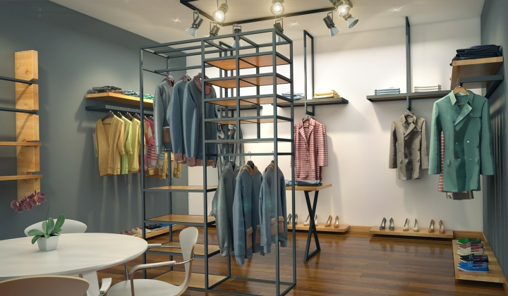
RETAIL LIGHTING DESIGN
Lighting Methods for Retail
Distribution and Direction of Light
Ambient Lighting
Perimeter Lighting
Accent Lighting
Decorative Lighting
Feature and Supplementary Lighting
Rack Lighting (Clothing)
Shelf and Gondola Lighting
Counter Lighting
Modeling Lighting
Mirror Lighting
Showcase Lighting
Wall-Case Lighting
Notes:
Lighting is an important part of a total shop concept; it can evoke feelings, strengthen your brand and effect sales. Our mission is to use lighting as a tool to enhance the shopping experience.
We feel passionate about retail lighting and can cover the entire spectrum of your lighting project – with high-quality products, education, concept development, on demand design, light planning, aiming and, crucially, on-going maintenance.

Slide 27
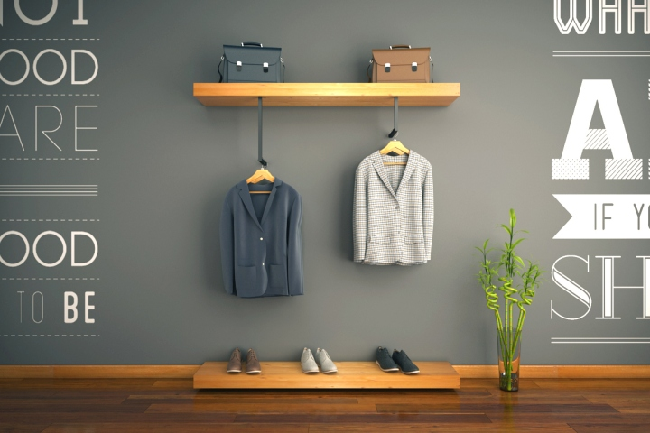
RETAIL LIGHTING DESIGN
Lighting Methods for Retail
Distribution and Direction of Light
Ambient Lighting
Perimeter Lighting
Accent Lighting
Decorative Lighting
Feature and Supplementary Lighting
Rack Lighting (Clothing)
Shelf and Gondola Lighting
Counter Lighting
Modeling Lighting
Mirror Lighting
Showcase Lighting
Wall-Case Lighting
Notes:
Lighting is an important part of a total shop concept; it can evoke feelings, strengthen your brand and effect sales. Our mission is to use lighting as a tool to enhance the shopping experience.
We feel passionate about retail lighting and can cover the entire spectrum of your lighting project – with high-quality products, education, concept development, on demand design, light planning, aiming and, crucially, on-going maintenance.

Slide 28
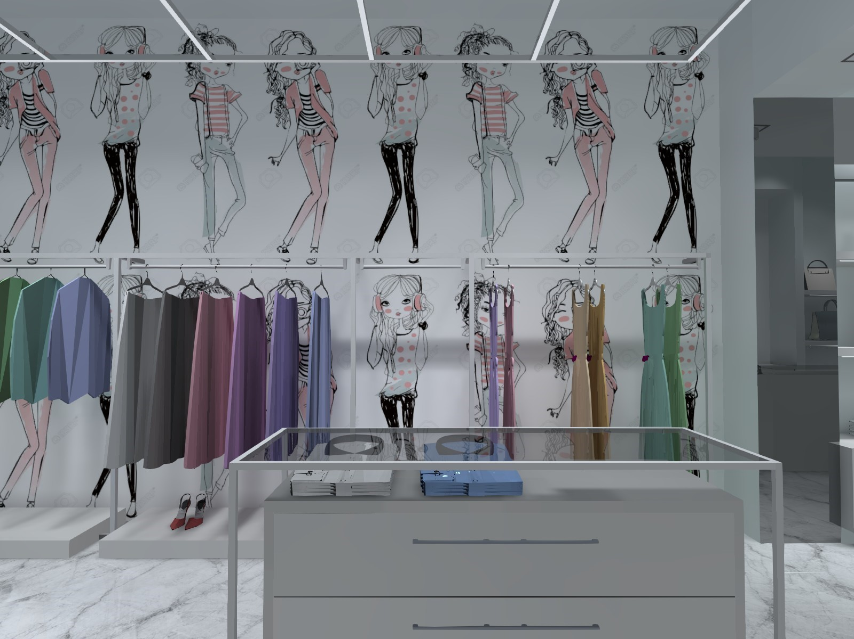
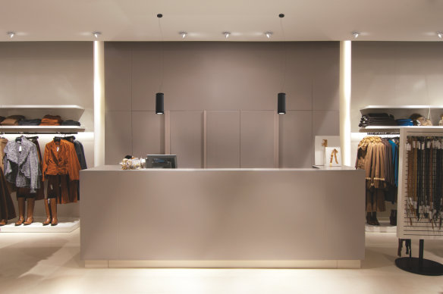
RETAIL LIGHTING DESIGN
Lighting Methods for Retail
Distribution and Direction of Light
Ambient Lighting
Perimeter Lighting
Accent Lighting
Decorative Lighting
Feature and Supplementary Lighting
Rack Lighting (Clothing)
Shelf and Gondola Lighting
Counter Lighting
Modeling Lighting
Mirror Lighting
Showcase Lighting
Wall-Case Lighting
Notes:
Lighting is an important part of a total shop concept; it can evoke feelings, strengthen your brand and effect sales. Our mission is to use lighting as a tool to enhance the shopping experience.
We feel passionate about retail lighting and can cover the entire spectrum of your lighting project – with high-quality products, education, concept development, on demand design, light planning, aiming and, crucially, on-going maintenance.

Slide 29
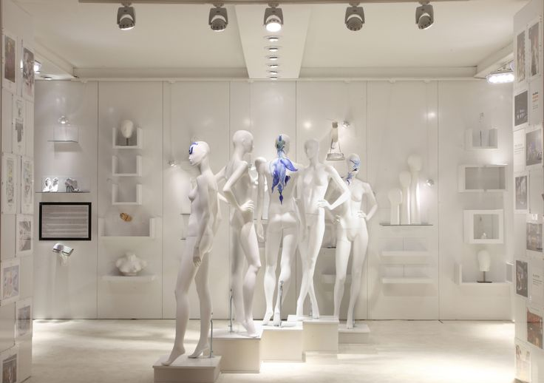
RETAIL LIGHTING DESIGN
Lighting Methods for Retail
Distribution and Direction of Light
Ambient Lighting
Perimeter Lighting
Accent Lighting
Decorative Lighting
Feature and Supplementary Lighting
Rack Lighting (Clothing)
Shelf and Gondola Lighting
Counter Lighting
Modeling Lighting
Mirror Lighting
Showcase Lighting
Wall-Case Lighting
Notes:
Lighting is an important part of a total shop concept; it can evoke feelings, strengthen your brand and effect sales. Our mission is to use lighting as a tool to enhance the shopping experience.
We feel passionate about retail lighting and can cover the entire spectrum of your lighting project – with high-quality products, education, concept development, on demand design, light planning, aiming and, crucially, on-going maintenance.

Slide 30

RETAIL LIGHTING DESIGN
Lighting Methods for Retail
Distribution and Direction of Light
Ambient Lighting
Perimeter Lighting
Accent Lighting
Decorative Lighting
Feature and Supplementary Lighting
Rack Lighting (Clothing)
Shelf and Gondola Lighting
Counter Lighting
Modeling Lighting
Mirror Lighting
Showcase Lighting
Wall-Case Lighting
Notes:
Lighting is an important part of a total shop concept; it can evoke feelings, strengthen your brand and effect sales. Our mission is to use lighting as a tool to enhance the shopping experience.
We feel passionate about retail lighting and can cover the entire spectrum of your lighting project – with high-quality products, education, concept development, on demand design, light planning, aiming and, crucially, on-going maintenance.

Slide 31

RETAIL LIGHTING DESIGN
Lighting Methods for Retail
Distribution and Direction of Light
Ambient Lighting
Perimeter Lighting
Accent Lighting
Decorative Lighting
Feature and Supplementary Lighting
Rack Lighting (Clothing)
Shelf and Gondola Lighting
Counter Lighting
Modeling Lighting
Mirror Lighting
Showcase Lighting
Wall-Case Lighting
Notes:
Lighting is an important part of a total shop concept; it can evoke feelings, strengthen your brand and effect sales. Our mission is to use lighting as a tool to enhance the shopping experience.
We feel passionate about retail lighting and can cover the entire spectrum of your lighting project – with high-quality products, education, concept development, on demand design, light planning, aiming and, crucially, on-going maintenance.

Slide 32

RETAIL LIGHTING DESIGN
Lighting Methods for Retail
Distribution and Direction of Light
Ambient Lighting
Perimeter Lighting
Accent Lighting
Decorative Lighting
Feature and Supplementary Lighting
Rack Lighting (Clothing)
Shelf and Gondola Lighting
Counter Lighting
Modeling Lighting
Mirror Lighting
Showcase Lighting
Wall-Case Lighting
Notes:
Lighting is an important part of a total shop concept; it can evoke feelings, strengthen your brand and effect sales. Our mission is to use lighting as a tool to enhance the shopping experience.
We feel passionate about retail lighting and can cover the entire spectrum of your lighting project – with high-quality products, education, concept development, on demand design, light planning, aiming and, crucially, on-going maintenance.

Slide 33
RETAIL LIGHTING DESIGN
Fading, Bleaching, and
Shelf-life
To control fading:
Rotating merchandise so that no one item receives the maximum amount of light exposure
Avoiding placement of merchandise directly under skylights or near store windows where light levels can be excessive
Avoiding placement of merchandise considered "highly susceptible" to fading (for example, cottons and silks) close to light sources
Sacrificing a few items to attract attention through higher accent lighting levels, and keeping the remainder of the merchandise under much lower light levels.
Notes:
Lighting is an important part of a total shop concept; it can evoke feelings, strengthen your brand and effect sales. Our mission is to use lighting as a tool to enhance the shopping experience.
We feel passionate about retail lighting and can cover the entire spectrum of your lighting project – with high-quality products, education, concept development, on demand design, light planning, aiming and, crucially, on-going maintenance.

Slide 34
RETAIL LIGHTING DESIGN
Design Considerations
Type of store
Merchandise sold
Projected store image
Age of the typical customer
Individual lighting needs and requirements of a store depend on many factors, including the type of store, type of merchandise sold, projected store image, and age of the typical customer. The selection of the appropriate illuminance for a specific task must also consider weighting factors such as age of the person, task importance, reflectance of task, and luminances of the environment. Also one should consider that certain stores may include a number of illumination scenarios in the same facility, resulting in deliberate non-uniform lighting.
Notes:
Lighting is an important part of a total shop concept; it can evoke feelings, strengthen your brand and effect sales. Our mission is to use lighting as a tool to enhance the shopping experience.
We feel passionate about retail lighting and can cover the entire spectrum of your lighting project – with high-quality products, education, concept development, on demand design, light planning, aiming and, crucially, on-going maintenance.

Slide 35

THANK YOU!
END OF PRESENTATION
www.nrocolightingdesign.com

